Slide 1
Results Fitness Programming S.Y.S.T.E.M.
Notes:
Save yourself time energy money

Slide 2
Thank You…
Alwyn and Rachel Cosgrove.
All of you for investing in yourself to be here to get better at what you do!
All of our colleagues and mentors for all they have taught and shared with us.
Perform Better

Slide 3
Principle Based Training
Systems vs. Tools
Systems vs. Randomization
Programs vs. Workouts - Review
Notes:
You need to have a REASON for everything in your program or you need to re-examine why it is there.
Is it a goal or a side effect
Easily replicable

Slide 4
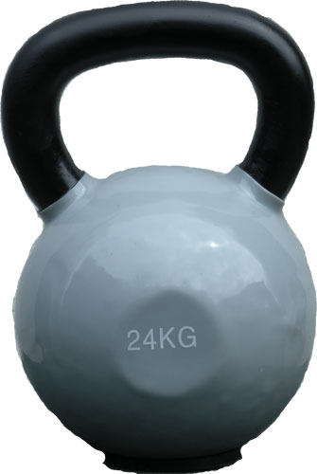

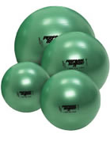
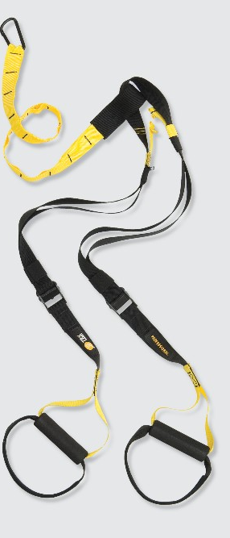
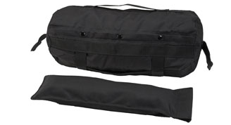
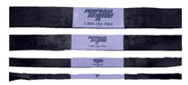
“ONE THING” Person
Doesn’t care what your goal is.
“Lose fat?”
“Feel better?”
“Gain muscle?”
“Improve Performance?”
-- The answer is “the one thing”
Notes:
Make sure the tool fits your principles and system.
Don’t be fooled because something is sexy.-new

Slide 5
Program Design - Rules of the Road
What is your destination? - Goal
All maps have a starting point. - Screening/Assessments
Draw the map. - Templates/Periodization
Take the direct route rather than the scenic route. - Big Rocks
Trust the map. - Stick to the Plan
Don't go into cruise control. - Programming Variables
Stay between the lines. - Checks & Balances
Use the carpool lane. - Semi-Private & Group Training
Pay attention to the gauges. - Recovery
Keep your maps. - Record Keeping

Slide 6
GOALS!!!
Every goal, regardless of client, will automatically generate a “template” – a physiological “blueprint” that will shape the entire program.
E.g. What does a fat loss template look like? What does a strength template look like?
Is it cookie cutter?
Keep the goal at the forefront when writing the program – EVERY SINGLE TIME!
Deliver the goal with respect to everything else!!!

Slide 7
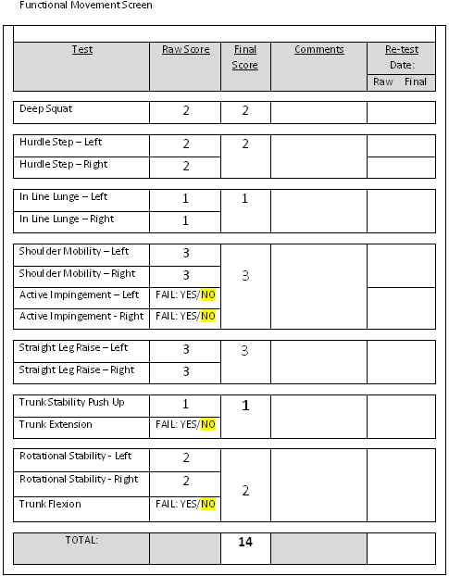
FMS Results

Slide 8
What does it tell you?
Identifies any risk factors.
What does a 19-21 tell you?
Two to three corrective exercises to fix a pattern (choose the lowest score/highest priority pattern).
Where to start.
Use of fillers/active rest for corrections for training economy.
Notes:
Are we supposed to be assymetric?

Slide 9
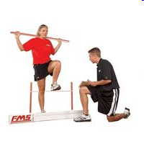
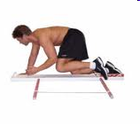
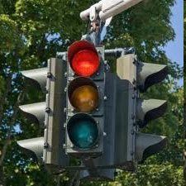

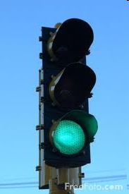

FMS Scope
0 =
1 =
2 =
3 =
Pain: Refer out. Send the client/athlete for diagnosis/evaluation/rehab.*
Cannot cleanly execute the pattern: Correct the pattern. Pattern is significantly limited/dysfunctional. Red Light*
Can execute the pattern with some degree of compensation. Can train the pattern, but may need to continue to work to correct the pattern. Yellow Light
Can cleanly execute the pattern. Train the pattern. Green Light
Notes:
* Do not externally load the pattern!!!!!!

Slide 10
How we use the screen as it pertains to exercise selection
“Our goal is to train everything - but ask yourself -
Does the screen suggest I eliminate something (contraindicated) from the program?
Does the screen suggest a regressed version of this movement is in order?
Does the screen suggest that this movement is cleared for training and overload?
The FMS is not what we use to design programs - a client’s goal is what we use first, then we evaluate to see where we start.” -- AC

Slide 11
Programs and Templates
What does a fat loss program look like?
What does a performance program look like?
Reconsider the addition of any activities that will not enhance the acquisition of the goal.
Have a reason for everything!

Slide 12
How long is the overall program/training cycle?
Time is a key factor in program design and it is often overlooked.
How long have you got to achieve the goal? MUST be realistic!
Regardless of the client, you must think in terms of the entire training cycle.
Notes:
We work backwards from the goal, reverse engineer their programs and stages

Slide 13
PROGRAMS - Not Workouts
Keeping the big picture in mind – we design long-term programs for success that consist of (chunking it down):
Shorter programs – that consist of:
Weekly workouts – that consist of:
Separate workouts – that consist of:
Exercises in a specific sequence, performed for sets, reps, at a given tempo, with set rest periods and appropriate loads.
Notes:
Most People start in the reverse order and design workouts around exercises

Slide 14
Terminology
Stage = The complete training plan - The PROGRAM!
Phase = The 4-6 training blocks consisting of the weekly and daily workouts.
Workout = Individual training days.
Notes:
Components of the workout.

Slide 15
Choose a Suitable Periodization Model
It’s less important which method you are using than it is to consciously follow a method of progression.
A few models to discuss…

Slide 16
Periodization Models
Linear Periodization: Involves a linear progression in lowering reps and increasing load (representing the inverse relationship between volume and intensity). For example:
Weeks 11 -1 3: 12 reps Weeks 14 -1 6: 10 reps Weeks 17 -1 9: 8 reps
Weeks 10 - 12: 6 reps, etc.
Notes:
Advantages and Disadvantages

Slide 17
Periodization Models
Non-Linear Alternating Periodization: Involves alternating between volume and intensity phases. For example:
Phase One - Weeks 11 - 14: 15 reps
Phase Two - Weeks 15 - 18: 10 reps
Phase Three - Weeks 19 - 12: 12 reps
Phase Four - Weeks 13 - 16: 8 reps
This is a base model and works very well (accumulate and intensify).
Notes:
Advantages and Disadvantages - Alternating periodization appears to be the most effective long term plan for most

Slide 18
Alternating periodization appears to be the most effective long-term plan for most.

Slide 19
Periodization Models
Undulating Periodization: Involves alternating between volume and intensity on a workout-by-workout basis within the same training week (can be done on a weekly basis as well). For example:
Week One: Mon: 5 reps, Wed: 15 reps, Fri: 10 reps
Typically used with an A-B (different exercises per day) split. So…
Week One
Mon Workout A – 15 reps
Wed Workout B – 15 reps
Fri Workout A – 10 reps
Week Two
Mon Workout B – 15 reps
Wed Workout A – 15 reps
Fri Workout B – 10 reps
Notes:
Advantages and disadvantages – not for beginners due to load selection issues
Variety is fun

Slide 20

How often…
Muscle Confusion?

Slide 21
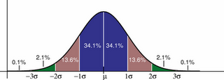
How often?
3-6 exposures
4-6 weeks on each phase
10 phases

Slide 22
Select the Frequency of Workouts per Week
How many sessions per week?
Must be grounded in reality for your client!
Optimal amount of sessions for a fat loss client?

Slide 23
Determine the Days of the Week for the Training Sessions
Realize that the fatigue generated by one workout may influence the training effect of the next workout.
Again, reality vs. optimal.
Plan the sequence accordingly, before you plan exercise selection.
Notes:
What will have to be different 12 weeks from now, if you make a change

Slide 24
Your Training Week (Fat Loss)

Slide 25
Programming Variables
1. Repetitions
2. Sets
3. Loading
4. Tempo
5. Rest Periods
6. Exercise Selection (most individualized)
Notes:
Equipment as variable?

Slide 26
How Many Reps/Sets?
What is the single most important acute exercise variable?
Reps dictate the load - overload principle
Reps follow a neural-metabolic continuum
REPS: 1 2 3 4 5 6 7 8 9 10 11 12 13 14 15...16 17...20+
%RM: 100%..............................................................50%-
NEURAL………………….…..….METABOLIC
Notes:
Rep ranges from book
25-50 total reps rule –
inverse relationship between sets and reps

Slide 27
How ‘bout exercise selection?
A whole lot to say here…later.
Exercise progressions and regressions.
May be the least important variable, but the most discussed?

Slide 28
Workout Components
Metabolic Ramping - a.k.a RAMP (Range of Motion, Activation, Movement Prep)
Core
Combination/Power Development
Strength/Resistance Training
Energy System Training
Regeneration
Notes:
Everybody does everything

Slide 29
RAMP
Range of Motion: Stretching and/or mobility exercises.
Activation: Specific activation exercises for the often inhibited muscles around the hips and shoulder blades.
Movement Preparation: Dynamic stretch-ing and movements that take the body through large excursions and multiple planes of motion.
Notes:
/ Corrective has been absorbed /

Slide 30
Purpose of RAMP
Addresses soft tissue quality (via the foam roll and the lacrosse ball).
Improves muscle length/extensibility.
Improves mobility of the joints.
Elevates body/core temperature and increases blood flow.
Takes the body through multiple planes of movement to improve mobility.
Charges up and excites the nervous system to prepare the body for the demands of the workout and movement patterns (exercises) that will follow. Prepares the body for the squat, bend, single leg stance, lunge, push, pull, and core movements.
Notes:
*Sagitall plane mobility / frontal and transvers plane stabilty – unilateral work tri-planar?

Slide 31
Principles and Guidelines
Start ground based, lower intensity, less complex - standing in place - moving, dynamic, higher intensity, more complexity.
Inhibition/Activation
Tri-planar
Sets and Reps
Total Number of Exercises
Notes:
*Car Analogy **Fillers/Active Rest – training economy

Slide 32
Joint-by-Joint Approach
Joint Primary Training Needs
Ankle mobility (particularly sagittal)
Knee stability
Hip mobility (multi-planar)
Lumbar Spine stability
T-spine mobility
Scapula stability
Glenohumeral mobility
Notes:
All joints are a combination of mobility and stability – primary empahis is key to chart

Slide 33
Joint-by-Joint/FMS RAMP
Ankle Mob: ILL, DS
(1)
dorsiflexion
inversion
eversion
Hip Mobility/Hip Stabilizer Activation: ILL, DS, HS, ASLR
(2-3)
hip extension
hip external/internal rotation
hip flexion
straight leg separation
abduction/adduction
T/S Mobility: SM, ILL, DS
(1-2)
extension
rotation
Scapular Stability/Mobility: SM, TSPU
(1-2)
retraction
protraction
upward rotation
depression
posterior tilting
GH Mobility: (SM)
(1-?)
external rotation
internal rotation
flexion
Core:
(?)
anti-extension
anti-rotation
hip disassociation
Notes:
The Big 3 – not a bad program – this was what we used the build our template
How many? 8-12 total movements : t/s 1-2, hip mob 2-3, hip stab 1-2, ankle mob 1, scap stab 1-2 /
All Core All the Time

Slide 34
Basic RAMP Template
RAMP
Foam Roll/Ball SMR
Hip Stretch/Mobilization
Hip Stabilizer Activation Exercise (backside)
Hip Stabilizer Activation Exercise (side)
Thoracic Spine Mobility Exercise
Ankle Mobility Exercise
Scapular Stabilizer Activation Exercise (OKC/CKC)
Squat Mobility/Patterning Exercise
Hip Separation Exercise (SL stance)
Sagittal Plane Lunge Exercise
Frontal or Transverse Plane Lunge Exercise
Notes:
See descriptions from article – highly individualized based on FMS or screening information

Slide 35
Joint | Primary Training Need | Mode
Ankle | Mobility (particularly sagittal) | Self Mob Drills
Knee | Stability | Resistance Program
Hip | Mobility (multi-planar) - hybrid joint, needs stability too! | SMR, Stretch, Activations & Patterning
Lumbar Spine & Pelvis | Stability | Direct Core Program & Resistance Program
Thoracic Spine | Mobility | Self Mob Drills
Scapula | Stability - hybrid joint, needs mobility too! | Activations
Glenohumeral | Mobility | Stretch & Activations
Notes:
All Joints need a combination of Mobility and Stabiltiy
*Intergrated – “all core all the time” –
Big Toe Mobiltiy -

Slide 39
Core
Basic Stabilization: Rolling, Quadruped (Bird Dogs), Leg Lowering/Raising, etc.
Pure Static Stabilization: Side Plank, Front Plank, SL Plank, etc.
Dynamic Stabilization:
Static Hips/Dynamic Shld: Chops & Lifts, Val Slide Push Aways, TRX Fall Outs, Body Saws, Stir the Pot, etc.
Static Shld/Dynamic Hips: Marching Planks, Jack Knives, Farmer’s Walks, Pikes, etc.
Integrated Stabilization: Wood Chop Variations, Get Ups, etc.

Slide 41
Power Development
Mike Boyle: “Older clients who train for power will be more independent, fall less often, and get better faster after an injury. A real trifecta. The bottom line - We need to forget all the crap about safety and start to figure out how to train all of our clients for power…”
Lots of med ball stuff for general populations.
Kettlebells/Sandbags
Speed/Agility Ladders?
RAMP?
Plyometric/Olympic Lifts & variations for those that are “qualified”.

Slide 42
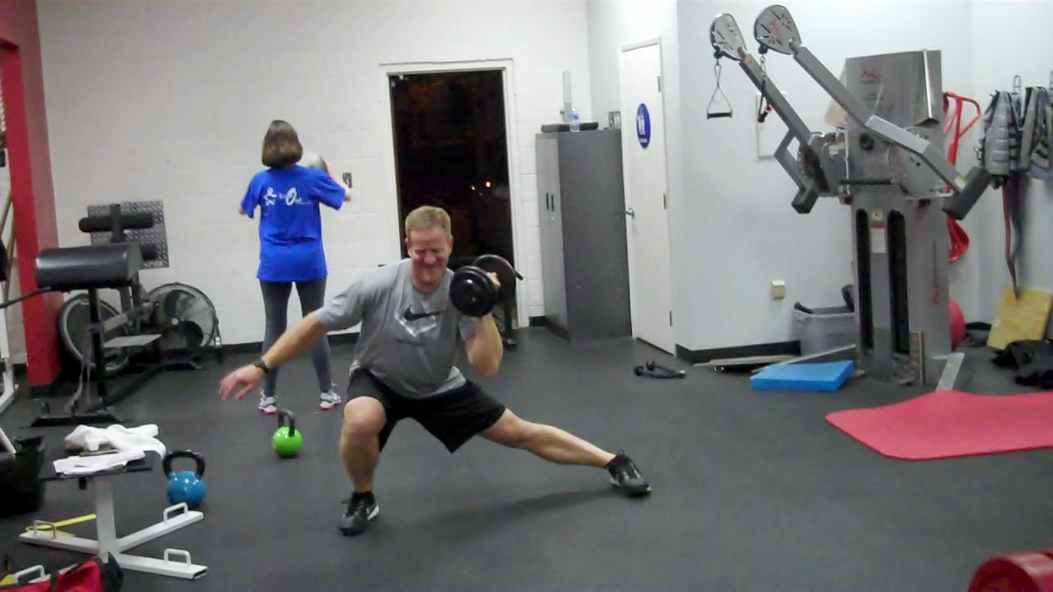
Combinations
Definitions: Combinations, Hybrids, Complexes
Finally, they have a home…
Why and how we use them: linked systems?
How we write them: + - ,
Lateral Lunge + SA DB Press (contra)
DB Front Squat - Press
RDL, Bent Over Row, Hang Power Clean, Push Press, Back Squat

Slide 43
Resistance Training
The “meat and potatoes” of a program.
The structural backbone that gives the most return on investment for goals. (Fat loss, strength gain, performance, etc.)
Our #1 on our hierarchy list of means to achieve body composition change via movement.
- Due to its involvement in adding lean body mass.

Slide 44
Our Classifications for Resistance Exercises
Squat
Bend
Lunge
Single Leg Stance
Pull
Push

Slide 45
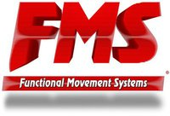
Correlations with the FMS
Squat/Bend – DS/ASLR
Push – TSPU/SM
Pull – SM?
SL Stance – HS/ASLR
Lunge – ILL
Core – RS/TSPU
Notes:
Functional Foot Position

Slide 46
Squat
Arms Extended Squat
Goblet Squat
Front Squat
Back Squat
Jump Squat
Notes:
Bilateral?

Slide 47
Bend
Hip Bridge
Pull Through
RDL
Rack DL
Hex/Trap Bar DL
Deadlift
Sumo DL
Snatch Grip DL
Deficit DL
SHELC (Ball Leg Curl)
GHR

Slide 48
Regeneration
Concept to improve the rate of super-compensation (get better results in less time) - move the curve up and to the left.
No one improves by training…
- You improve by RECOVERING FROM training.
- If you have a training program, you need a recovery program too.
Notes:
You can squeeze in more frequency if the curve moves to the left

Slide 49
Templates
Building a template that incorporates as many of the “sub-steps” as possible makes this an easy to implement system than can be duplicated!
Templates are a time saver once the front end work is done.
Notes:
80% of the program is already done

Slide 50
Workout Components
Metabolic Ramping - a.k.a RAMP (Range of Motion, Activation, Movement Prep)
Core
Combination/Power Development
Strength/Resistance Training
Energy System Training
Regeneration
Notes:
A reminder slide for the next slide

Slide 51
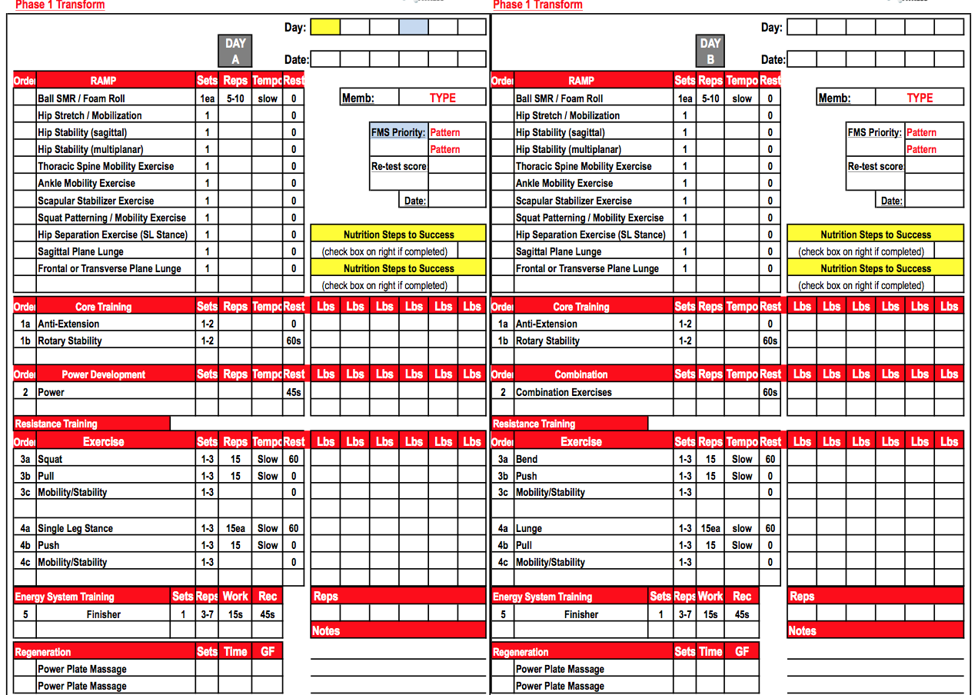

Slide 52
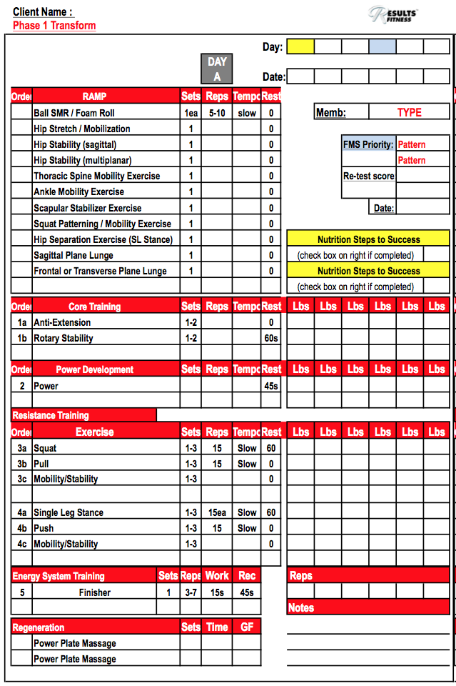

Slide 53
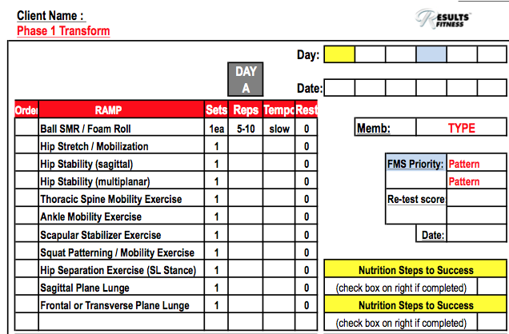

Slide 54
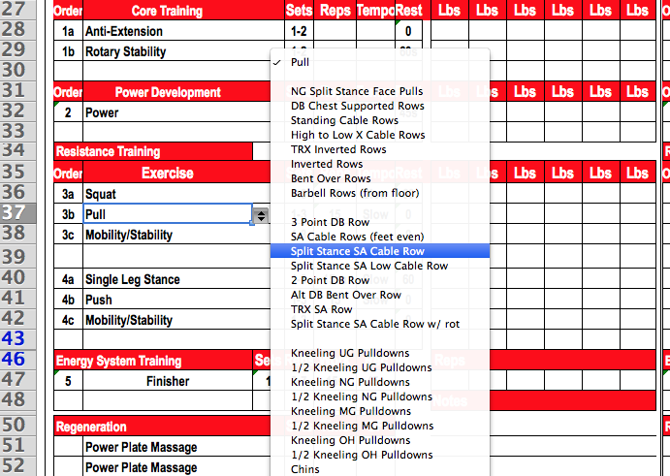

Slide 55
Cheat Sheet
What is the client’s GOAL?
Select a periodization plan including sets, reps, tempo, and rest periods. - Templates?
Go through the assessment/screen to determine starting point, priorities to be trained, and any areas of concern.
Select the most appropriate exercises for each movement pattern and allocate them to each workout day.
Check your work.
Select the exercises for the next phase.

Slide 56
?

Slide 57
www.resultsfitnessuniversity.com

