Slide 1
Building Your Team

Slide 2
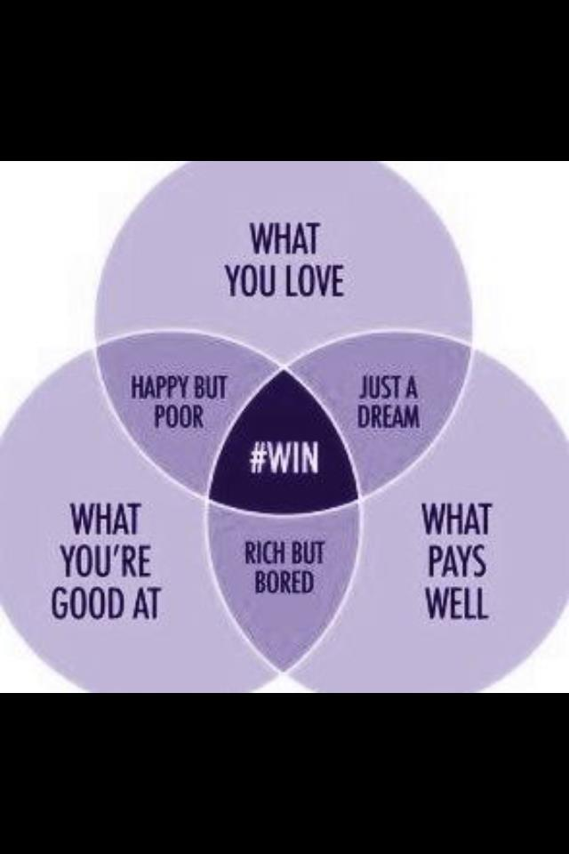

Slide 3
Hire Slow, Fire Fast
Resume
Pick Up a Questionnaire at the Gym
Phone Interview
Interview/Group Interview
Shadowing/Interning

Slide 4
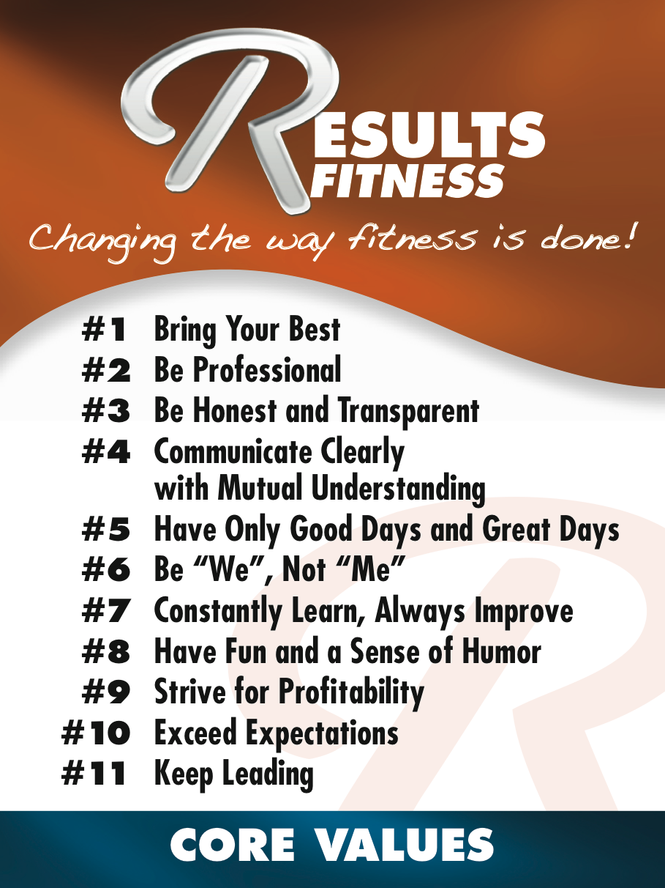

Slide 5
Interview Based on Core Values
Tell me a joke. - Fun and Humor
What book has had - Constant learning
the biggest Impact and never ending
on your life? improvement
YOUR TURN

Slide 6
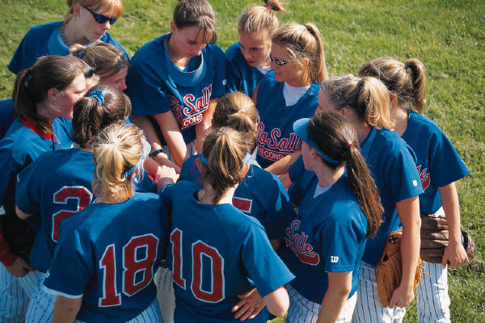
Building and leading your team

Slide 7

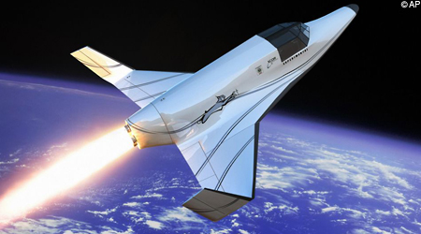
Good to Great by Jim Collins

Slide 8


Slide 9
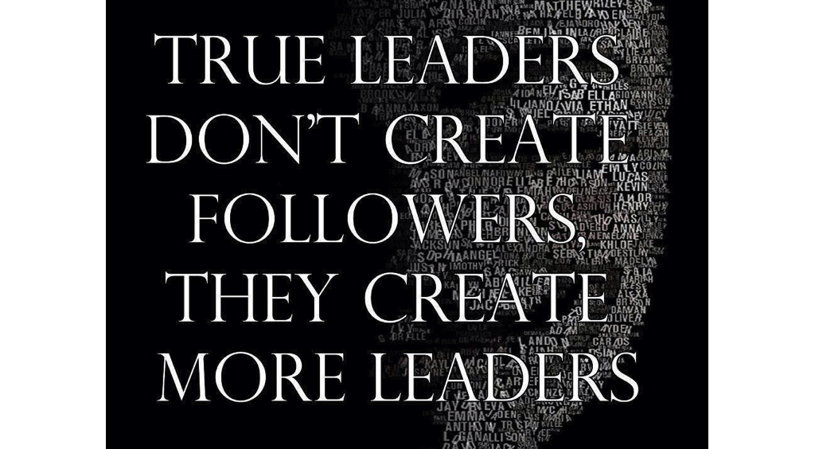

Slide 10
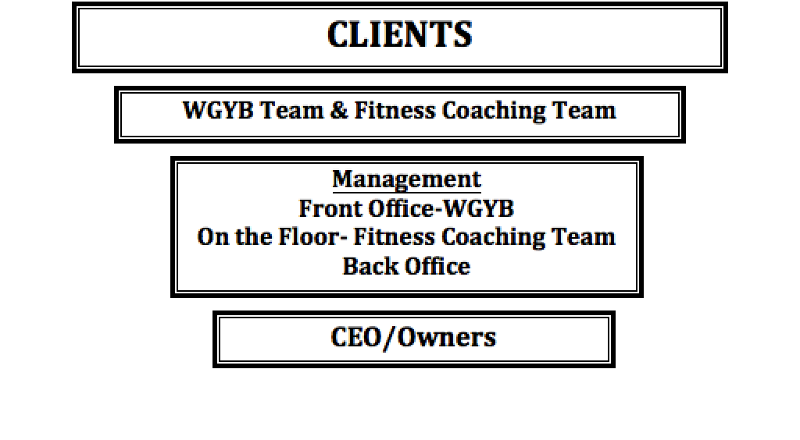

Slide 11
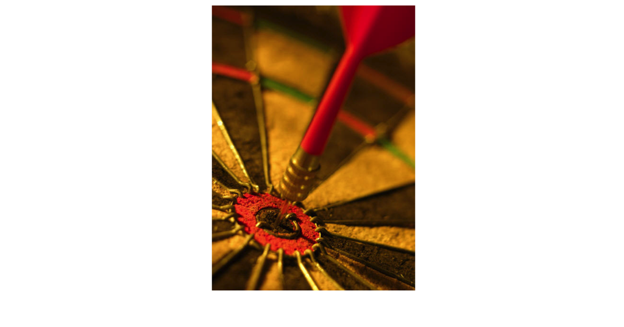
Everyone knows
the goals

Slide 12
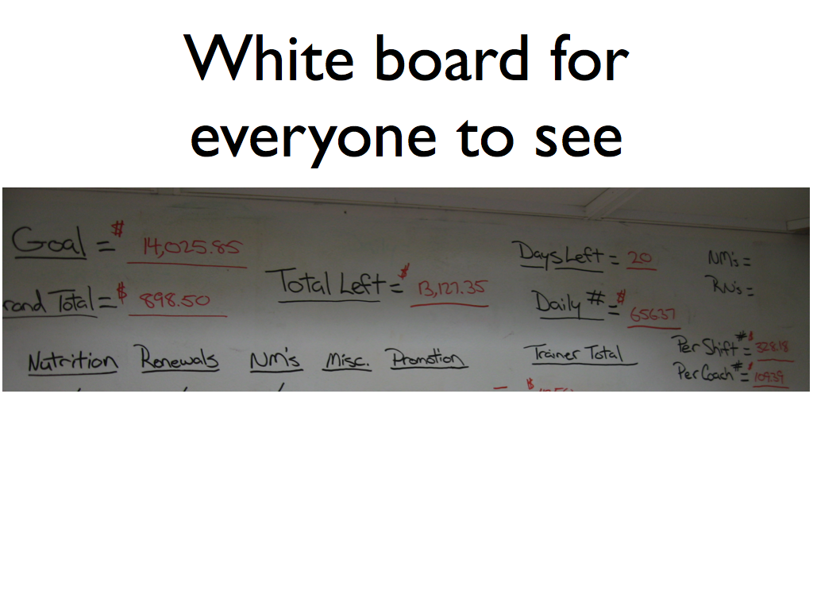

Slide 13
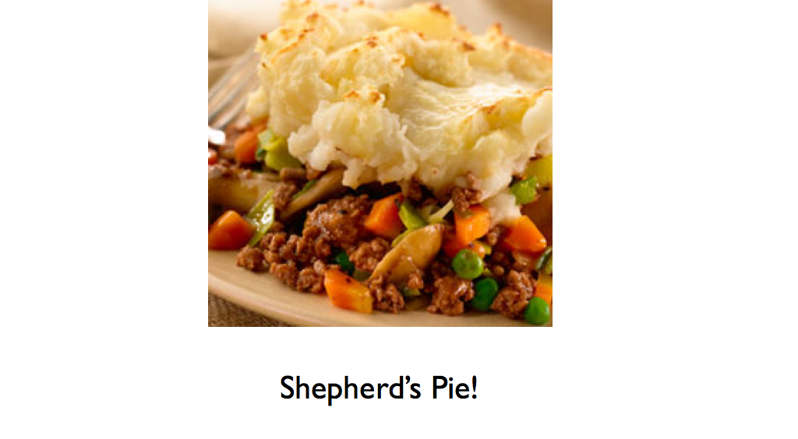

Slide 14
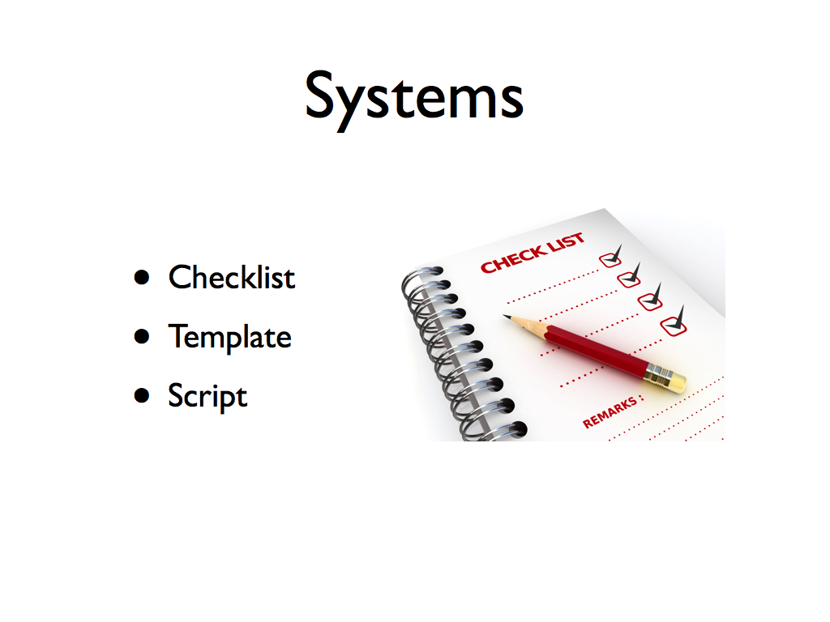

Slide 15
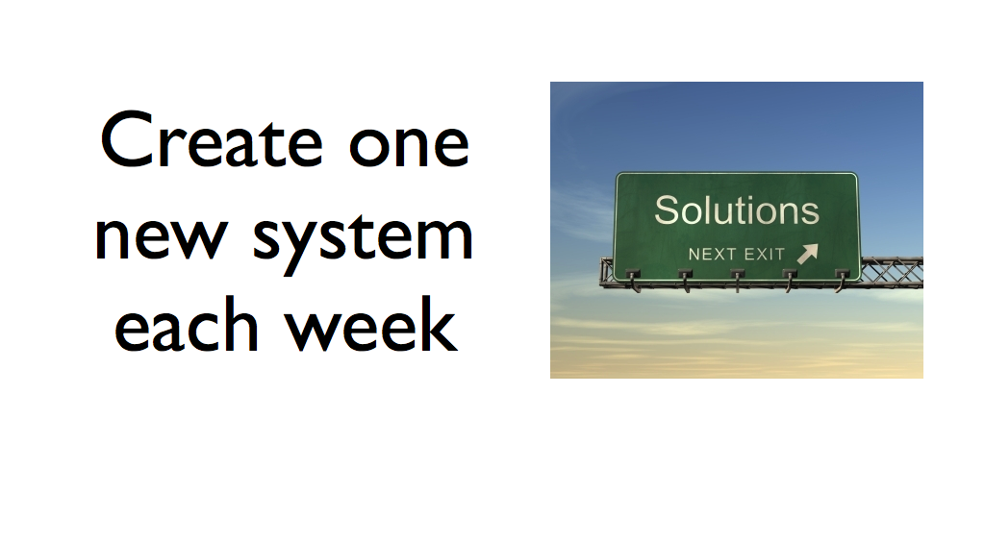

Slide 16
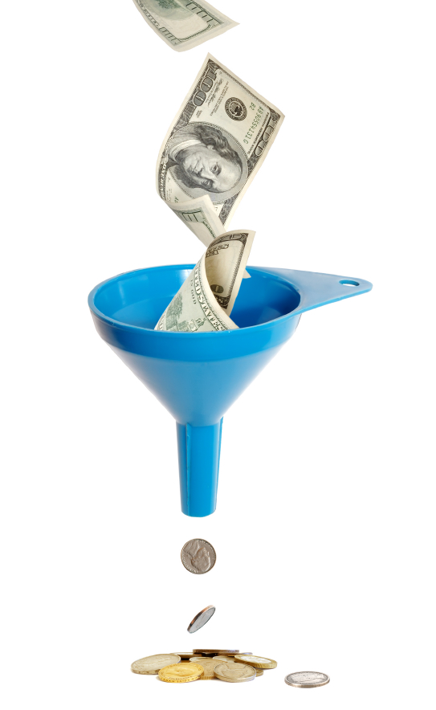

Slide 17

Systems that run based on your CORE VALUES

Slide 18

Core Values

Slide 19
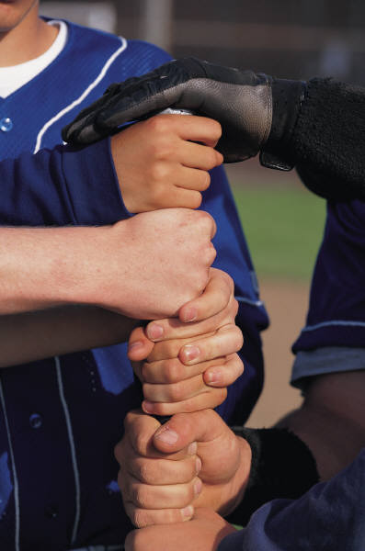
Empower Your Team

