Slide 1

The Results Fitness
Sales System

Slide 2
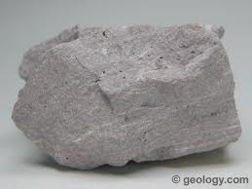
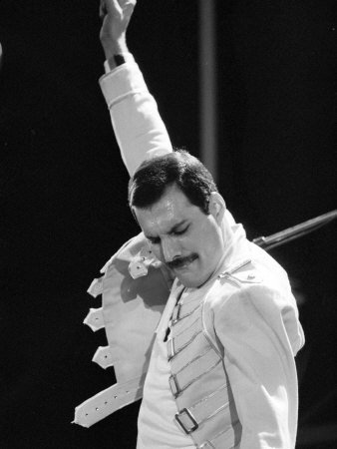

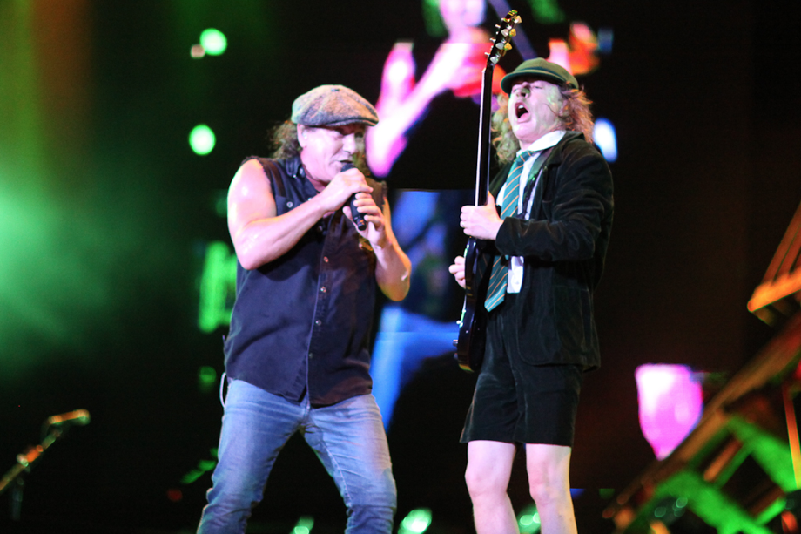


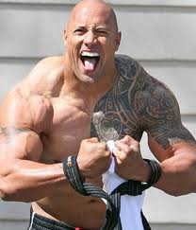

Let’s...
Notes:
CLOSE YOUR BOOKS!
What was the phone Number next to the hard rock café?

Slide 3
STEP 1 - THE INQUIRY
Create a system and scripts. USE THEM!
Take control and gather contact information.
Set an appointment.
Track it, track it, track it!

Slide 4
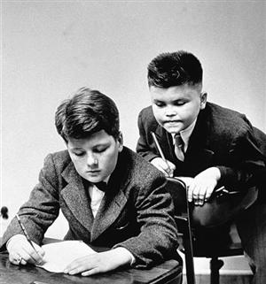
STEP 2 –
“IF YOU DON’T MIND...”
Send a welcome packet asking...
What?
Why?
Why not?

Slide 5
STEP 3 -
THEY'RE HERE!
Be prepared ahead of time.
BE PREPARED AHEAD OF TIME.*
Have a formal file ready.
Open with a YES.
Practice your handshake.*

Slide 6
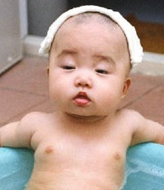
RELAX...
THEY'RE HERE ON PURPOSE
Be a good host, not a sales person.
Offer them a beverage (food is better).
Don't be afraid of small talk.
Notes:
Tell the Parol Study
Play the dating Game

Slide 7
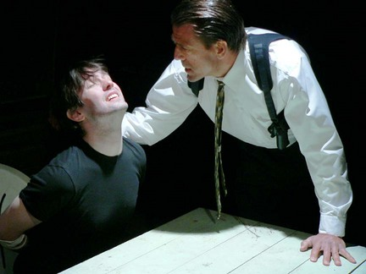
STEP 4 - BUILD RAPPORT,
ESTABLISH TRUST
BULD RAPPORT,
ESTABLISH TRUST

Slide 8
Victory
Achieved by
Listening Understanding Empathizing

Slide 9
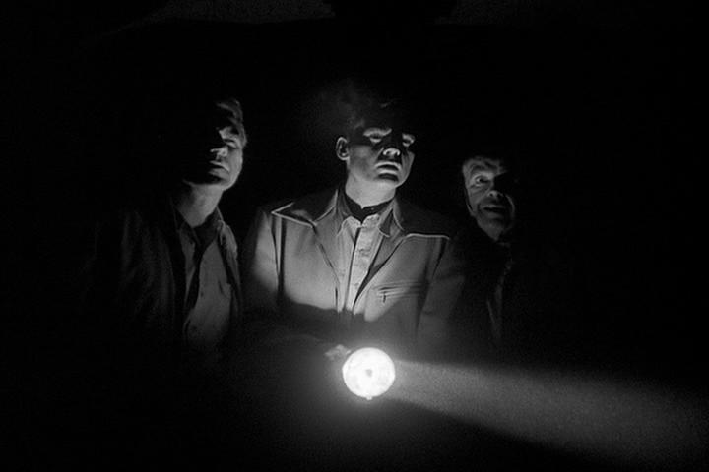
ONE MINUTE TO BUILD RAPPORT

Slide 10
STEP 5 - THEIR GOALS, THEIR LANGUAGE, THEIR GYM
The four reasons people join a gym.
Dig deep, get emotional, and defend it with logic.
Write it down in their language.
Help them paint a picture of the future.

Slide 11
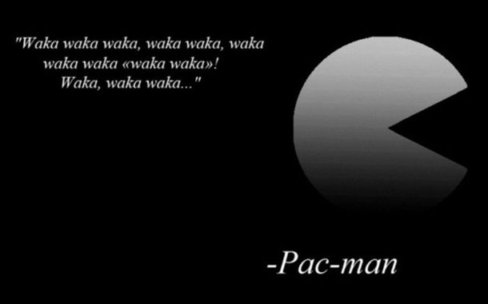
MOVING THE CONVERSATION ALONG

Slide 12
STEP 6 - TOUR OF THE FUTURE...
It's not about the toys or the space.
Feature - Benefit - Feedback
Use random (but not really) encounters; find a raving fan.
Find a link to something they love.
Get “hands on!”
Notes:
Start with the Ven Diagram

Slide 13
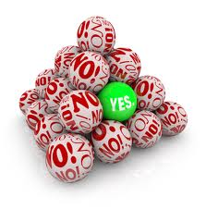
STEP 7 - CLOSING SHOULD BE
THE NATURAL NEXT STEP
Value has been established. No convincing! No fear!
It's not a price sheet, it's the way to achieve their goals.
You are professional council, not a sales person.
The A/B close

Slide 14
SECRET CLOSING TIPS
Most objections have already been covered.
Objections are buying signals. Overcome and circle back.
Be patient and zip it!*

Slide 15
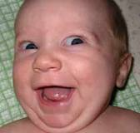
STEP 8 – OMG…
THEY SAID YES!
Close with a handshake (not only is it a time-honored tradition, but personal contact confirms a good decision.)
Don't hide your excitement.
If you can, share the work.
Set their first appointment A.S.A.P. !

Slide 16

I SIGNED UP AT YOUR GYM
AND ALL I GOT WAS
A YELLOW PIECE OF PAPER…
Leaving with only a copy of your contract sucks!
If you've been paying attention, give a 30-day membership for someone specific.
End 2

Slide 17
STEP 9 -
WANT TO KEEP EM?
BUT WAIT…
THERE’S
MORE!

Slide 18

“M” is for math…and McDonald’s
1973 - McDonald’s tests
“Would you like fries with that?”
in 10 locations.
Result - $218,840 increase IN PROFIT
in one year… $0.60 at a time.

Slide 19
Adjusted for inflation -
$1,092,523.51

Slide 20
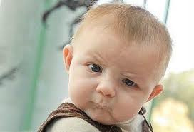
An Average of
$9,100 Per Year
Spent at Results Fitness by our most loyal members…and their friends
Are you serious?
Yes, I’m serious.

Slide 21
A
B
= Raving Fans
Big Spenders
(people who upgrade
and participate)
B
C
Raving Fans
= The Best Retention
(And Referrals)
A
C
Big Spenders
(people who upgrade
and participate)
= The Best Retention
(And Referrals)

Slide 22
UPGRADES AND
CROSS-SELLING
Turn out the lights, give them a candle, and offer a lamp.
Offer other services and products that will complement their training. (Keep it an easy soft sell).
Anything that you offer should not be a surprise (preview everything in the new member packet.)
Leaving opportunities out upsets your customers.
Notes:
Have people make a list of things they can cross sell.

Slide 23
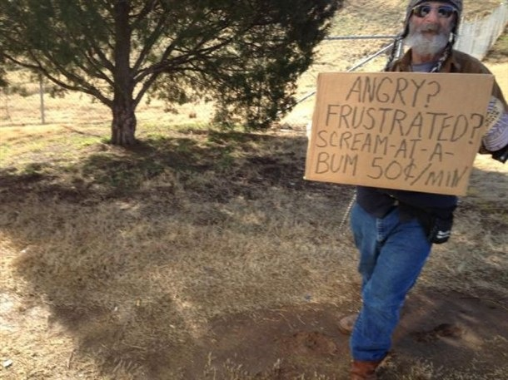
POP QUIZ!
End 3

