Slide 1

Semi-Private Training
& Group Classes:
Operation Systems

Slide 2
Evolution of “Personal Training”
  One-on-One
  Semi-Private
  Semi-Private 2.0
Notes:
Trainer counted reps
Client counted reps
Client in charge of knowing 3 things – the name, how many.
Gas Station Analogy – Client is more self directed

Slide 3
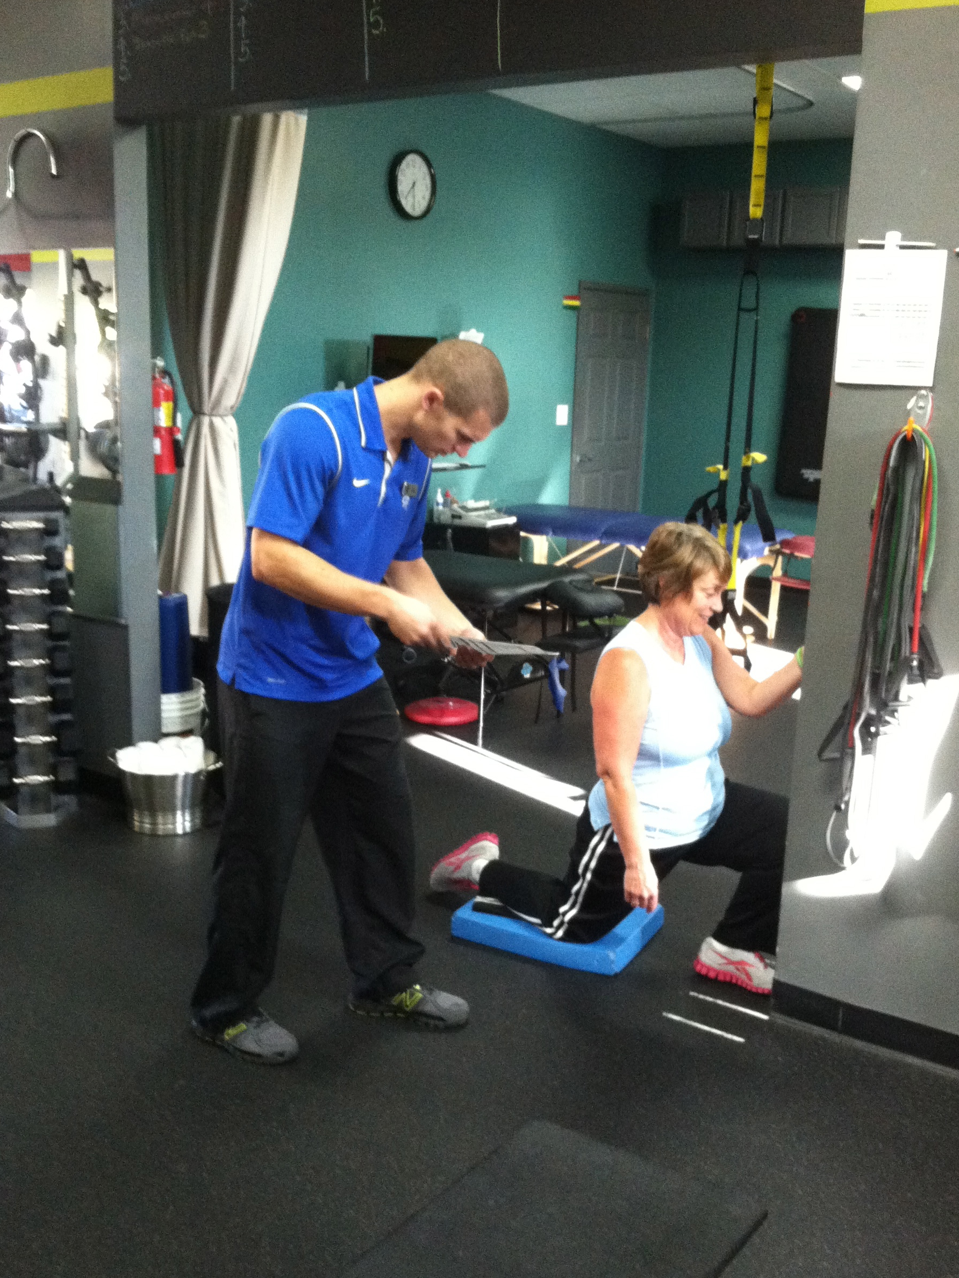
What is One-on-One?
1 client, 1 coach
Individual programs
Coached by same the trainer
Need I explain further?
Notes:
Counting Reps

Slide 4
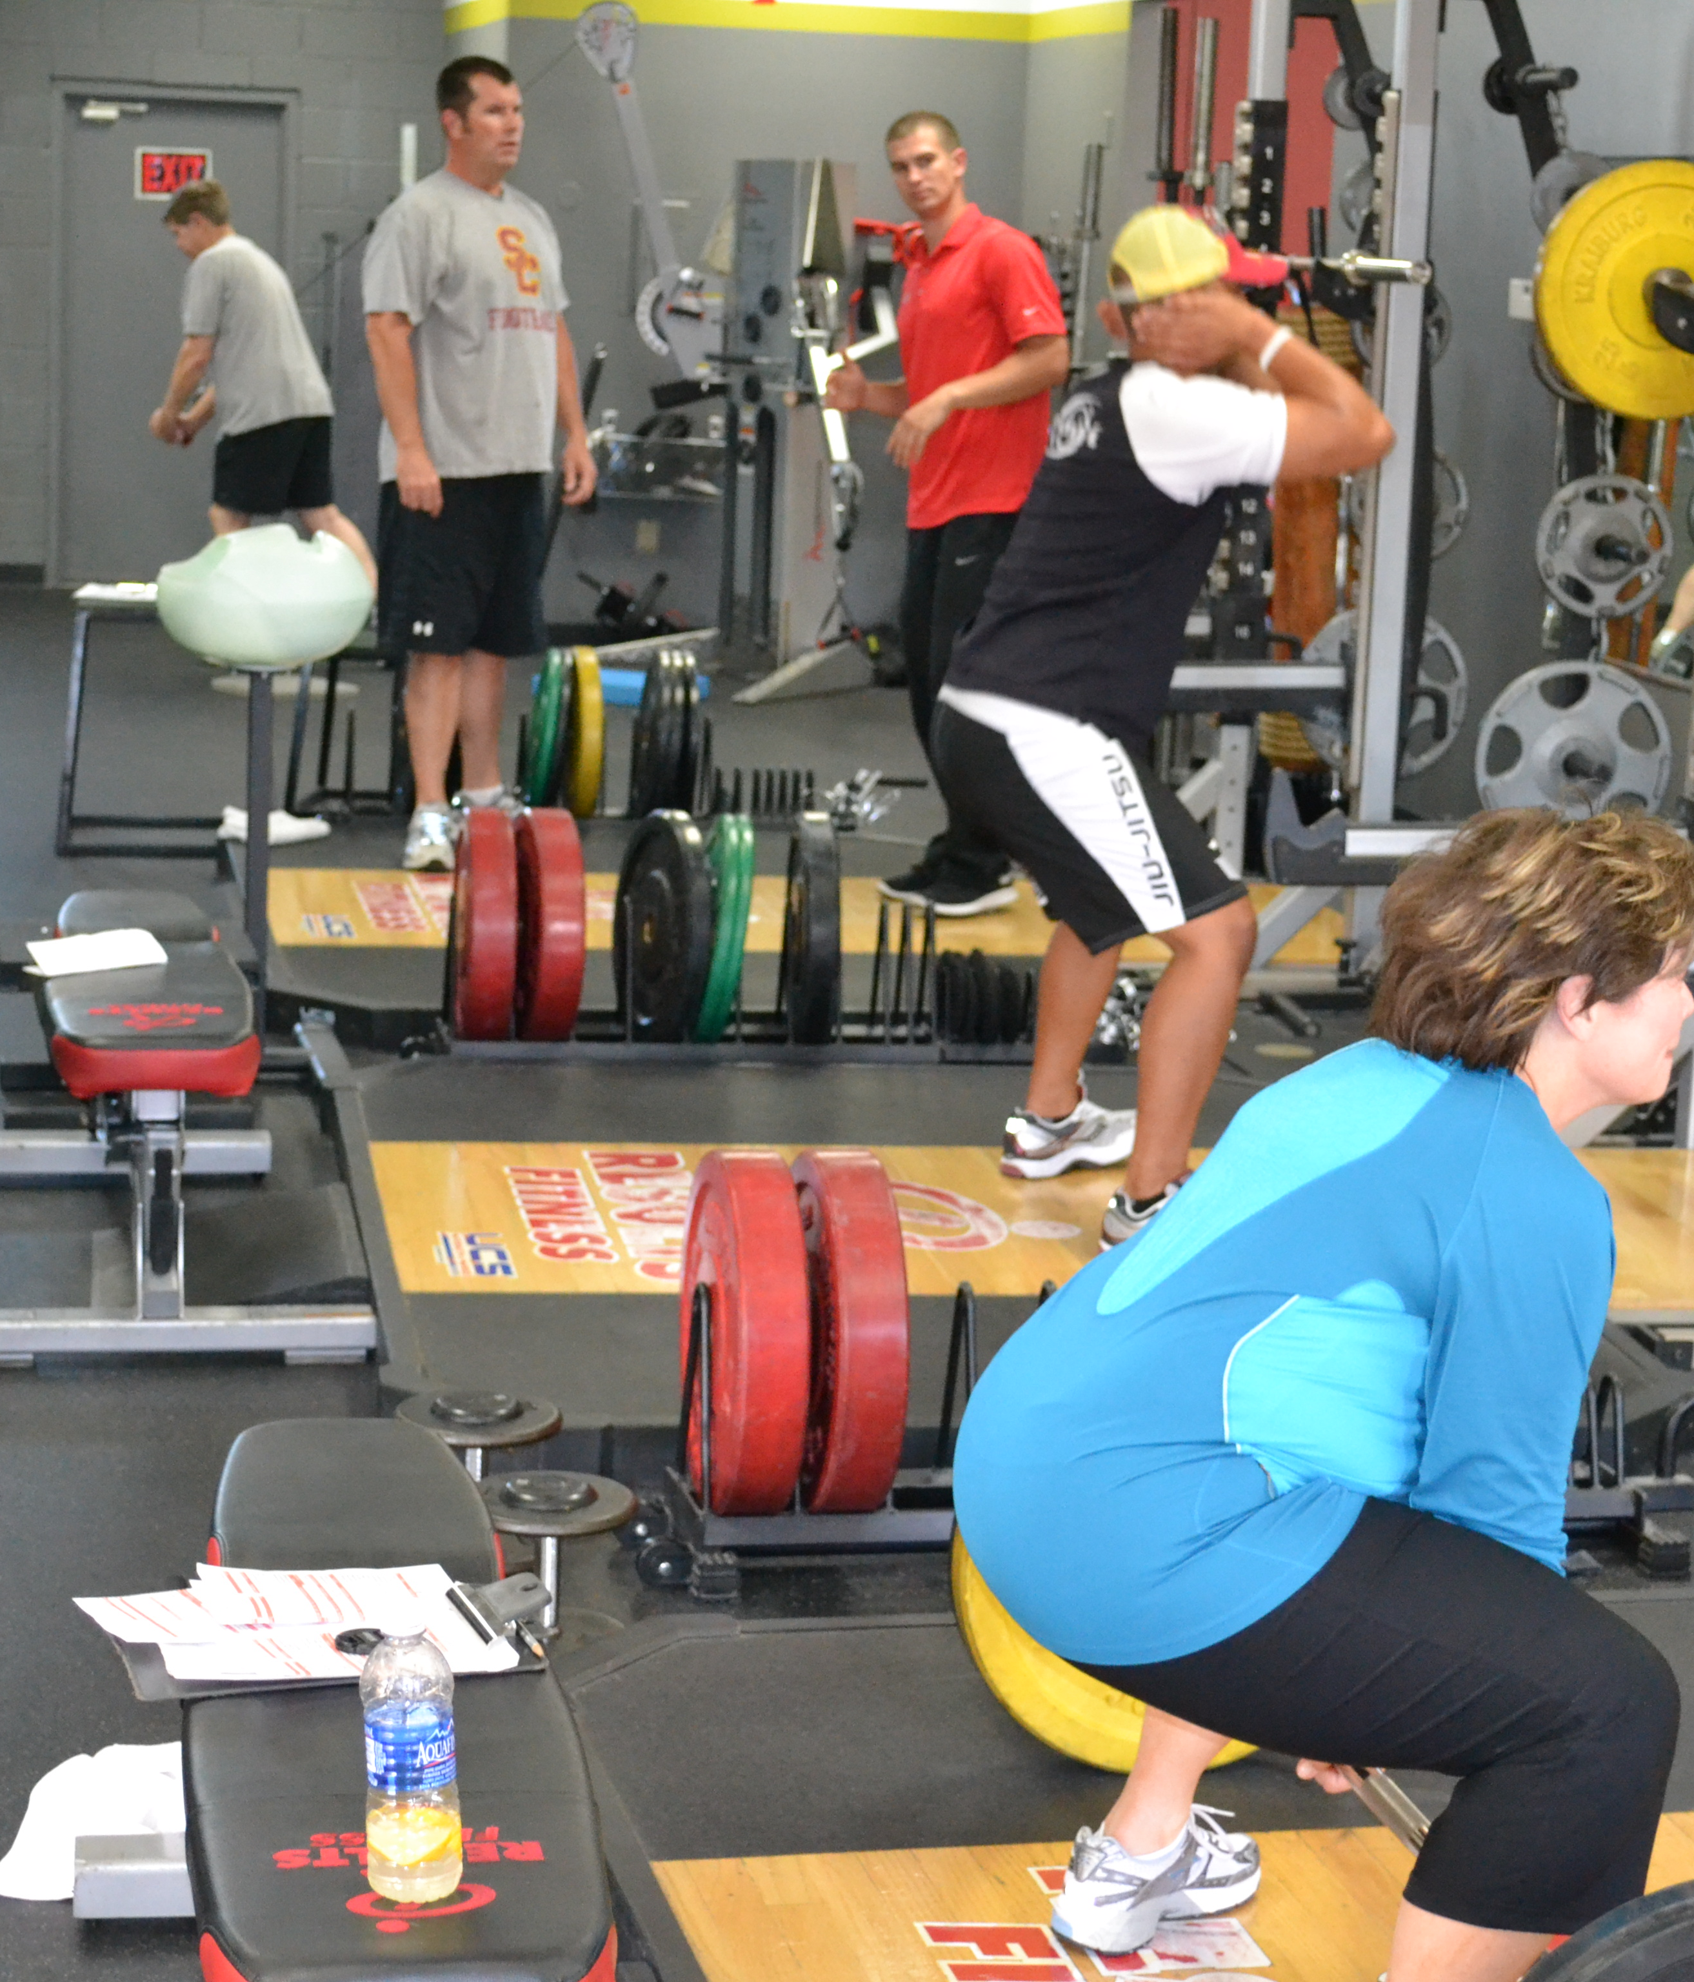
What is Semi-Private?
1-3 people in a group
Individual programs
Coached by same trainer
Coached at the same time
Notes:
Why 1-3 not 2-3?
Large group 4+

Slide 5
Pros and Cons of Semi-Private Training
Pros
  Less Expensive Membership
  Social Support/Setting
  Better Results
  Less Boring for Trainer
  Trainer has more free time.
  You Get to Help More People!
Notes:
“lower economic barrier to entry”
½ marathon story of cheering
3rd place

Slide 6
Pros and Cons of Semi-Private Training
Cons
  Clients used to one-on-one take some adaptation.
  Difficult at first, takes some getting used to.
  It’s harder!
  May put you in a higher tax bracket.
  Trainers/owners are afraid to take the leap.
Notes:
Core value Have Integrity, be Honest and Transparent
IRS story and fitbiz
----- Meeting Notes (6/29/12 07:57) -----
clients dont know any better, "its just what we do”
Honor contracts

Slide 7
FAQs
Do you group people based on their:
Abilities?
Age?
Goals?
Experience?
Notes:
Pre-emptive strikes
Typically people get caught up on the outliers and standard deviation rarities

Slide 8
FAQs
We group people based on their schedule.
Three people an hour
Grandmother works out next to housewife - who works out next to college athlete.

Slide 9
FAQs
How do you keep track of their data?
Notes:
Coach fills in workout sheet-
Client fills out when working out on own-

Slide 10
FAQs
The client keeps track of their:
  Reps
  Sets
  Rest Periods
The coach keeps track of the clients’:
  Loading
  Equipment Set-up
  Logistics

Slide 11
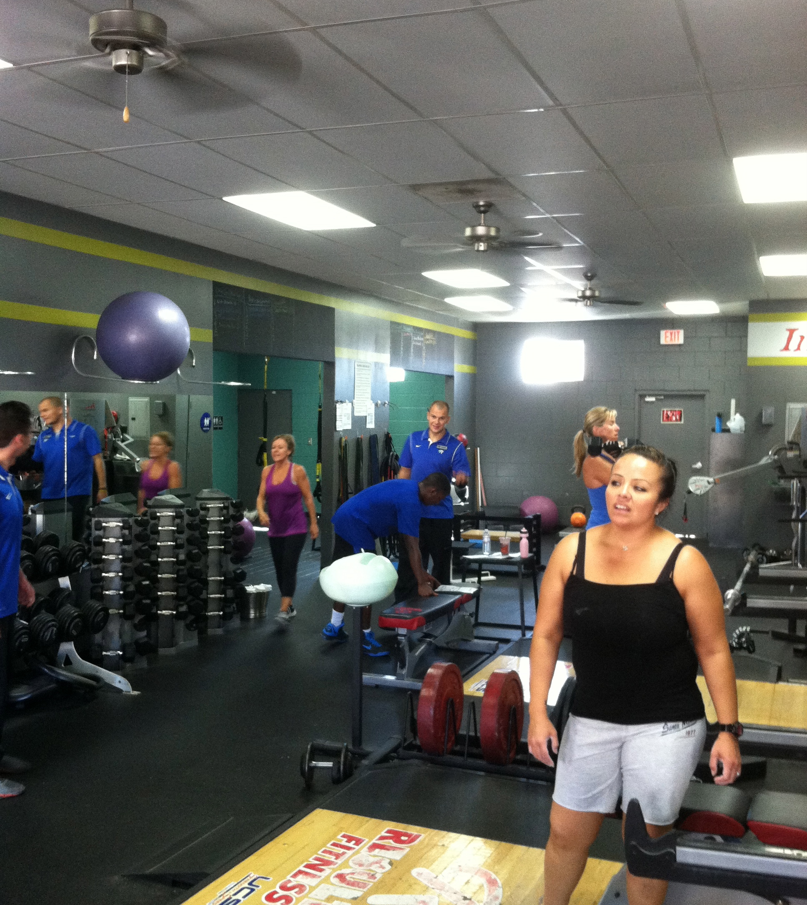
What is Semi-Private 2.0?!
1-8 people in a time slot.
Individual programs
All eight people coached by two trainers.
Individual programs delivered in a team environment.
Notes:
2 can coach 8 better than 1 can coach 3. Liberation from too much program management and hand holding – uneeded.
What do you need a coach for?

Slide 12
How’s it work?
Preparation of Programs
Choosing loads post (or during) workout – hand sheet to a coach when finished.
Zone (Area) Training – Think Basketball
Debrief Session & Nutrition
Liberate yourself from carrying around their program sheet!
Notes:
Self service, full service gas station analogy

Slide 13
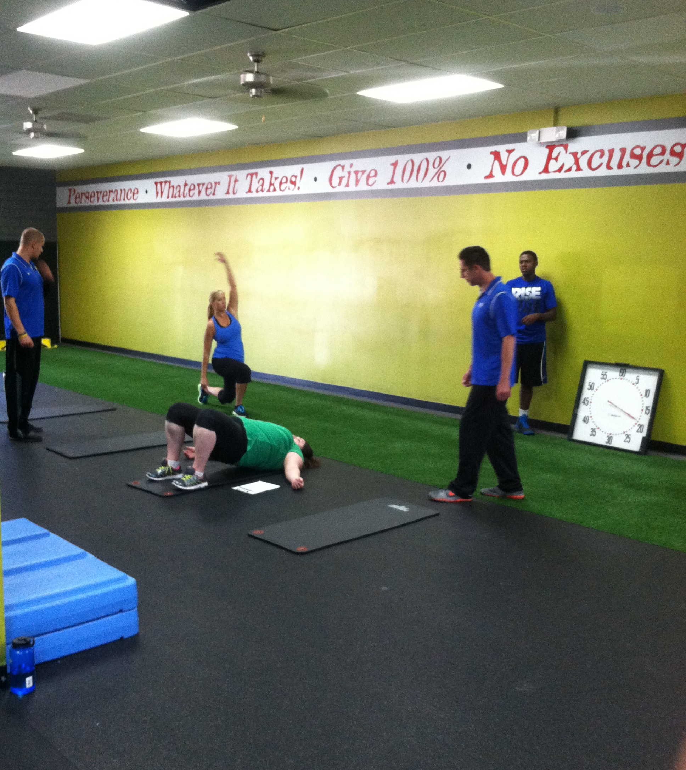
More Pros Than Cons
No tunnel vision
Interruptions
Modeling
New coaches get better faster
Much more coaching for the clients

Slide 14
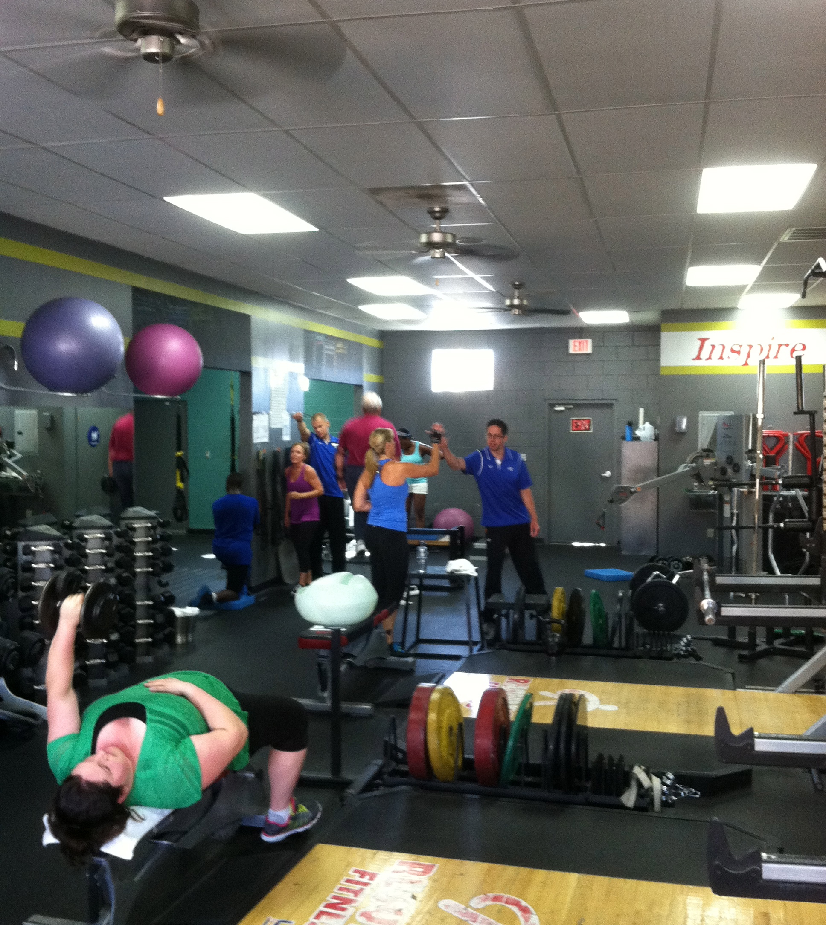
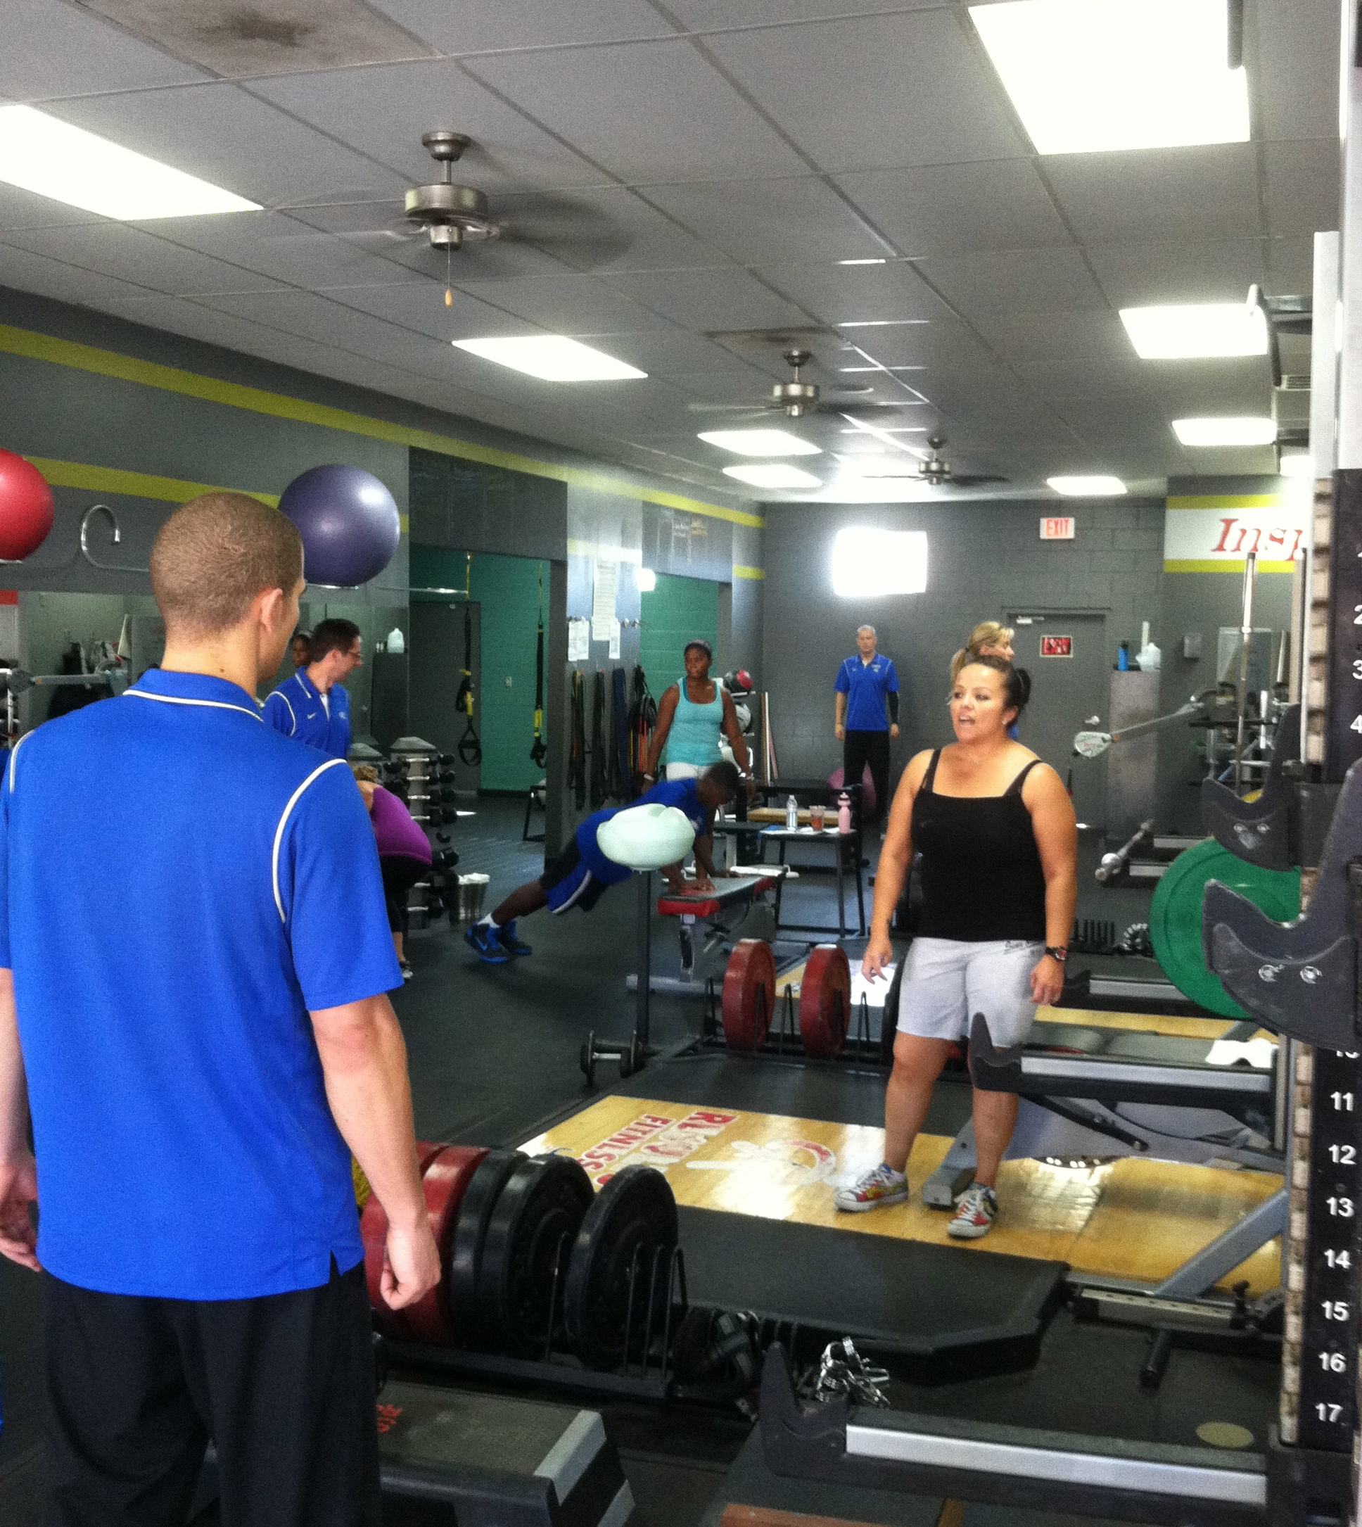
Zones (Areas)

Slide 15
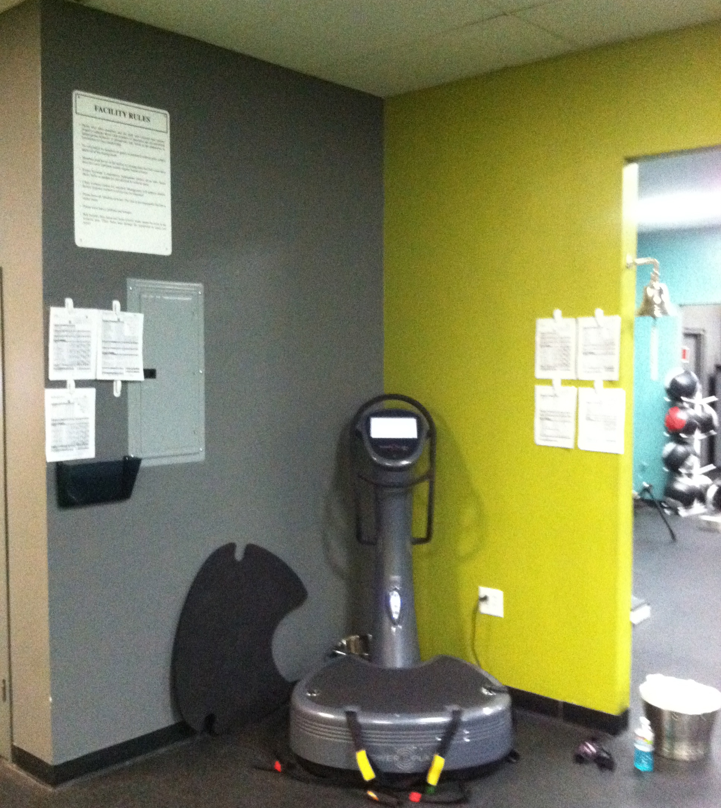
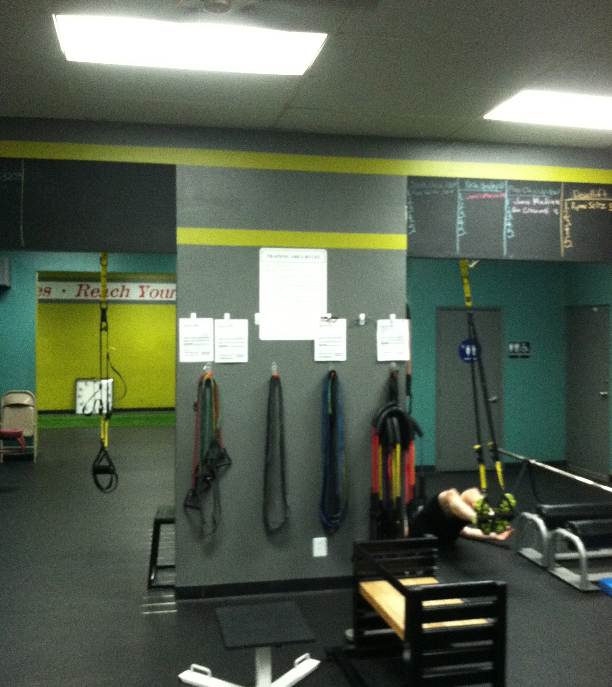

Slide 16
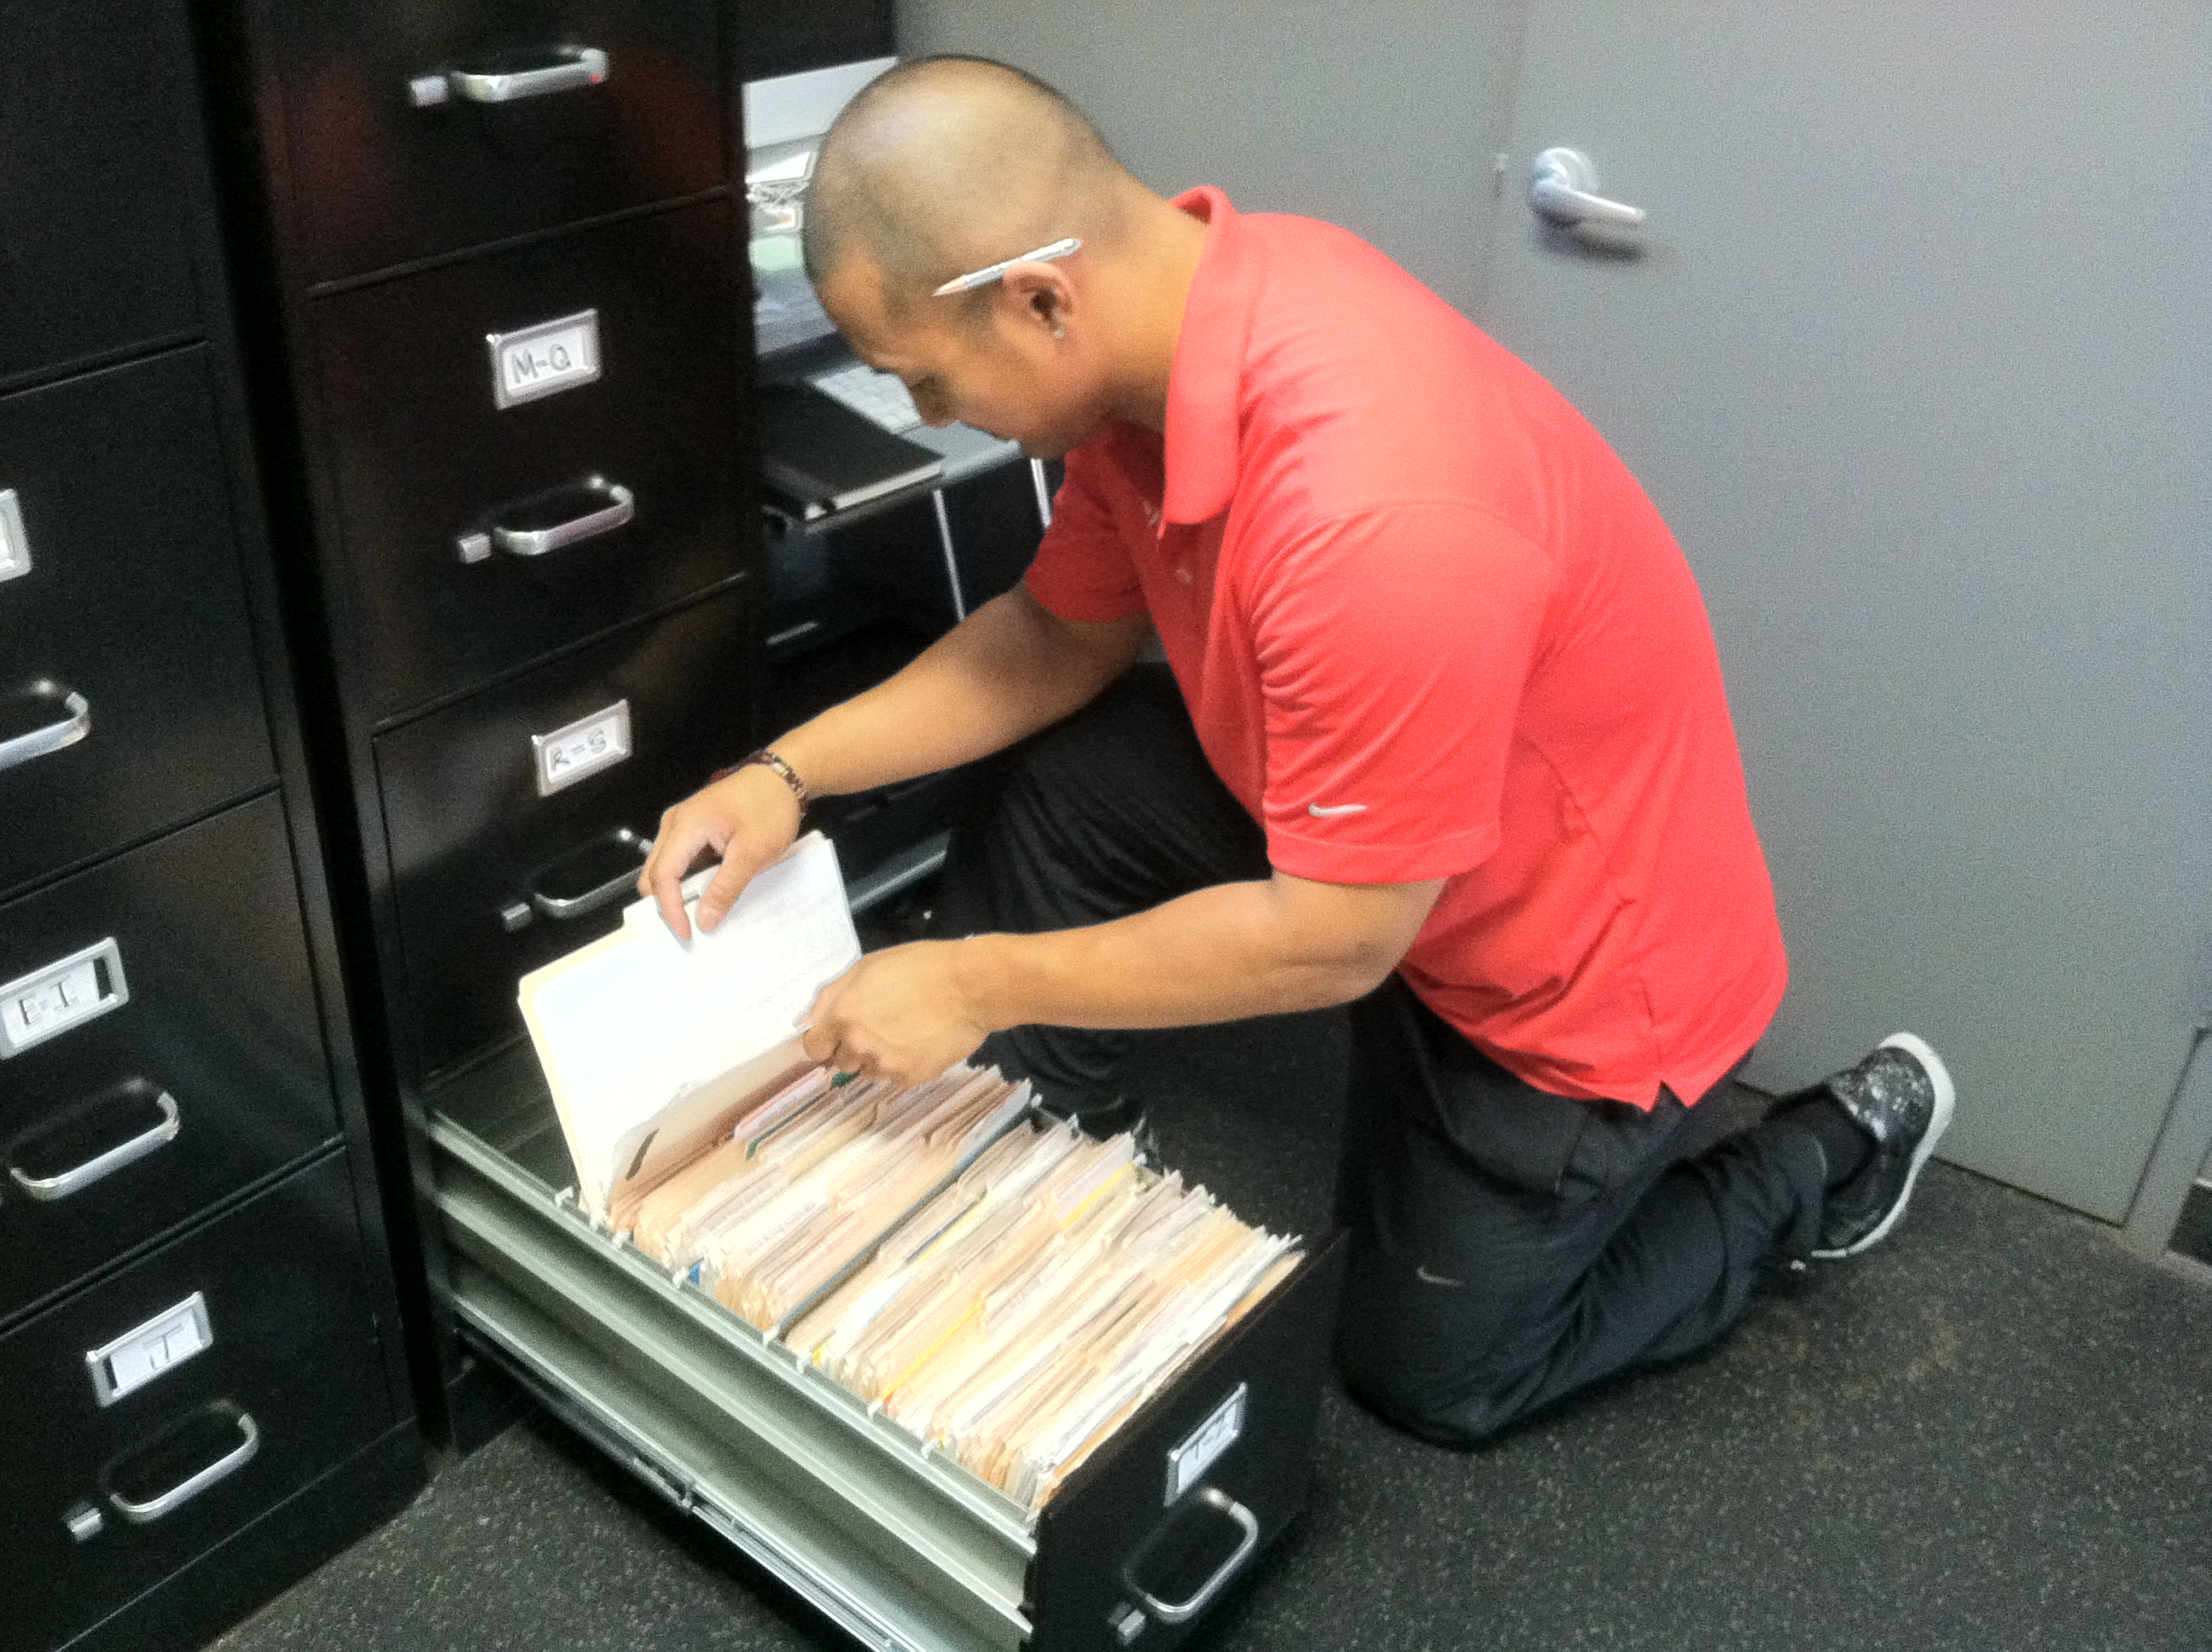
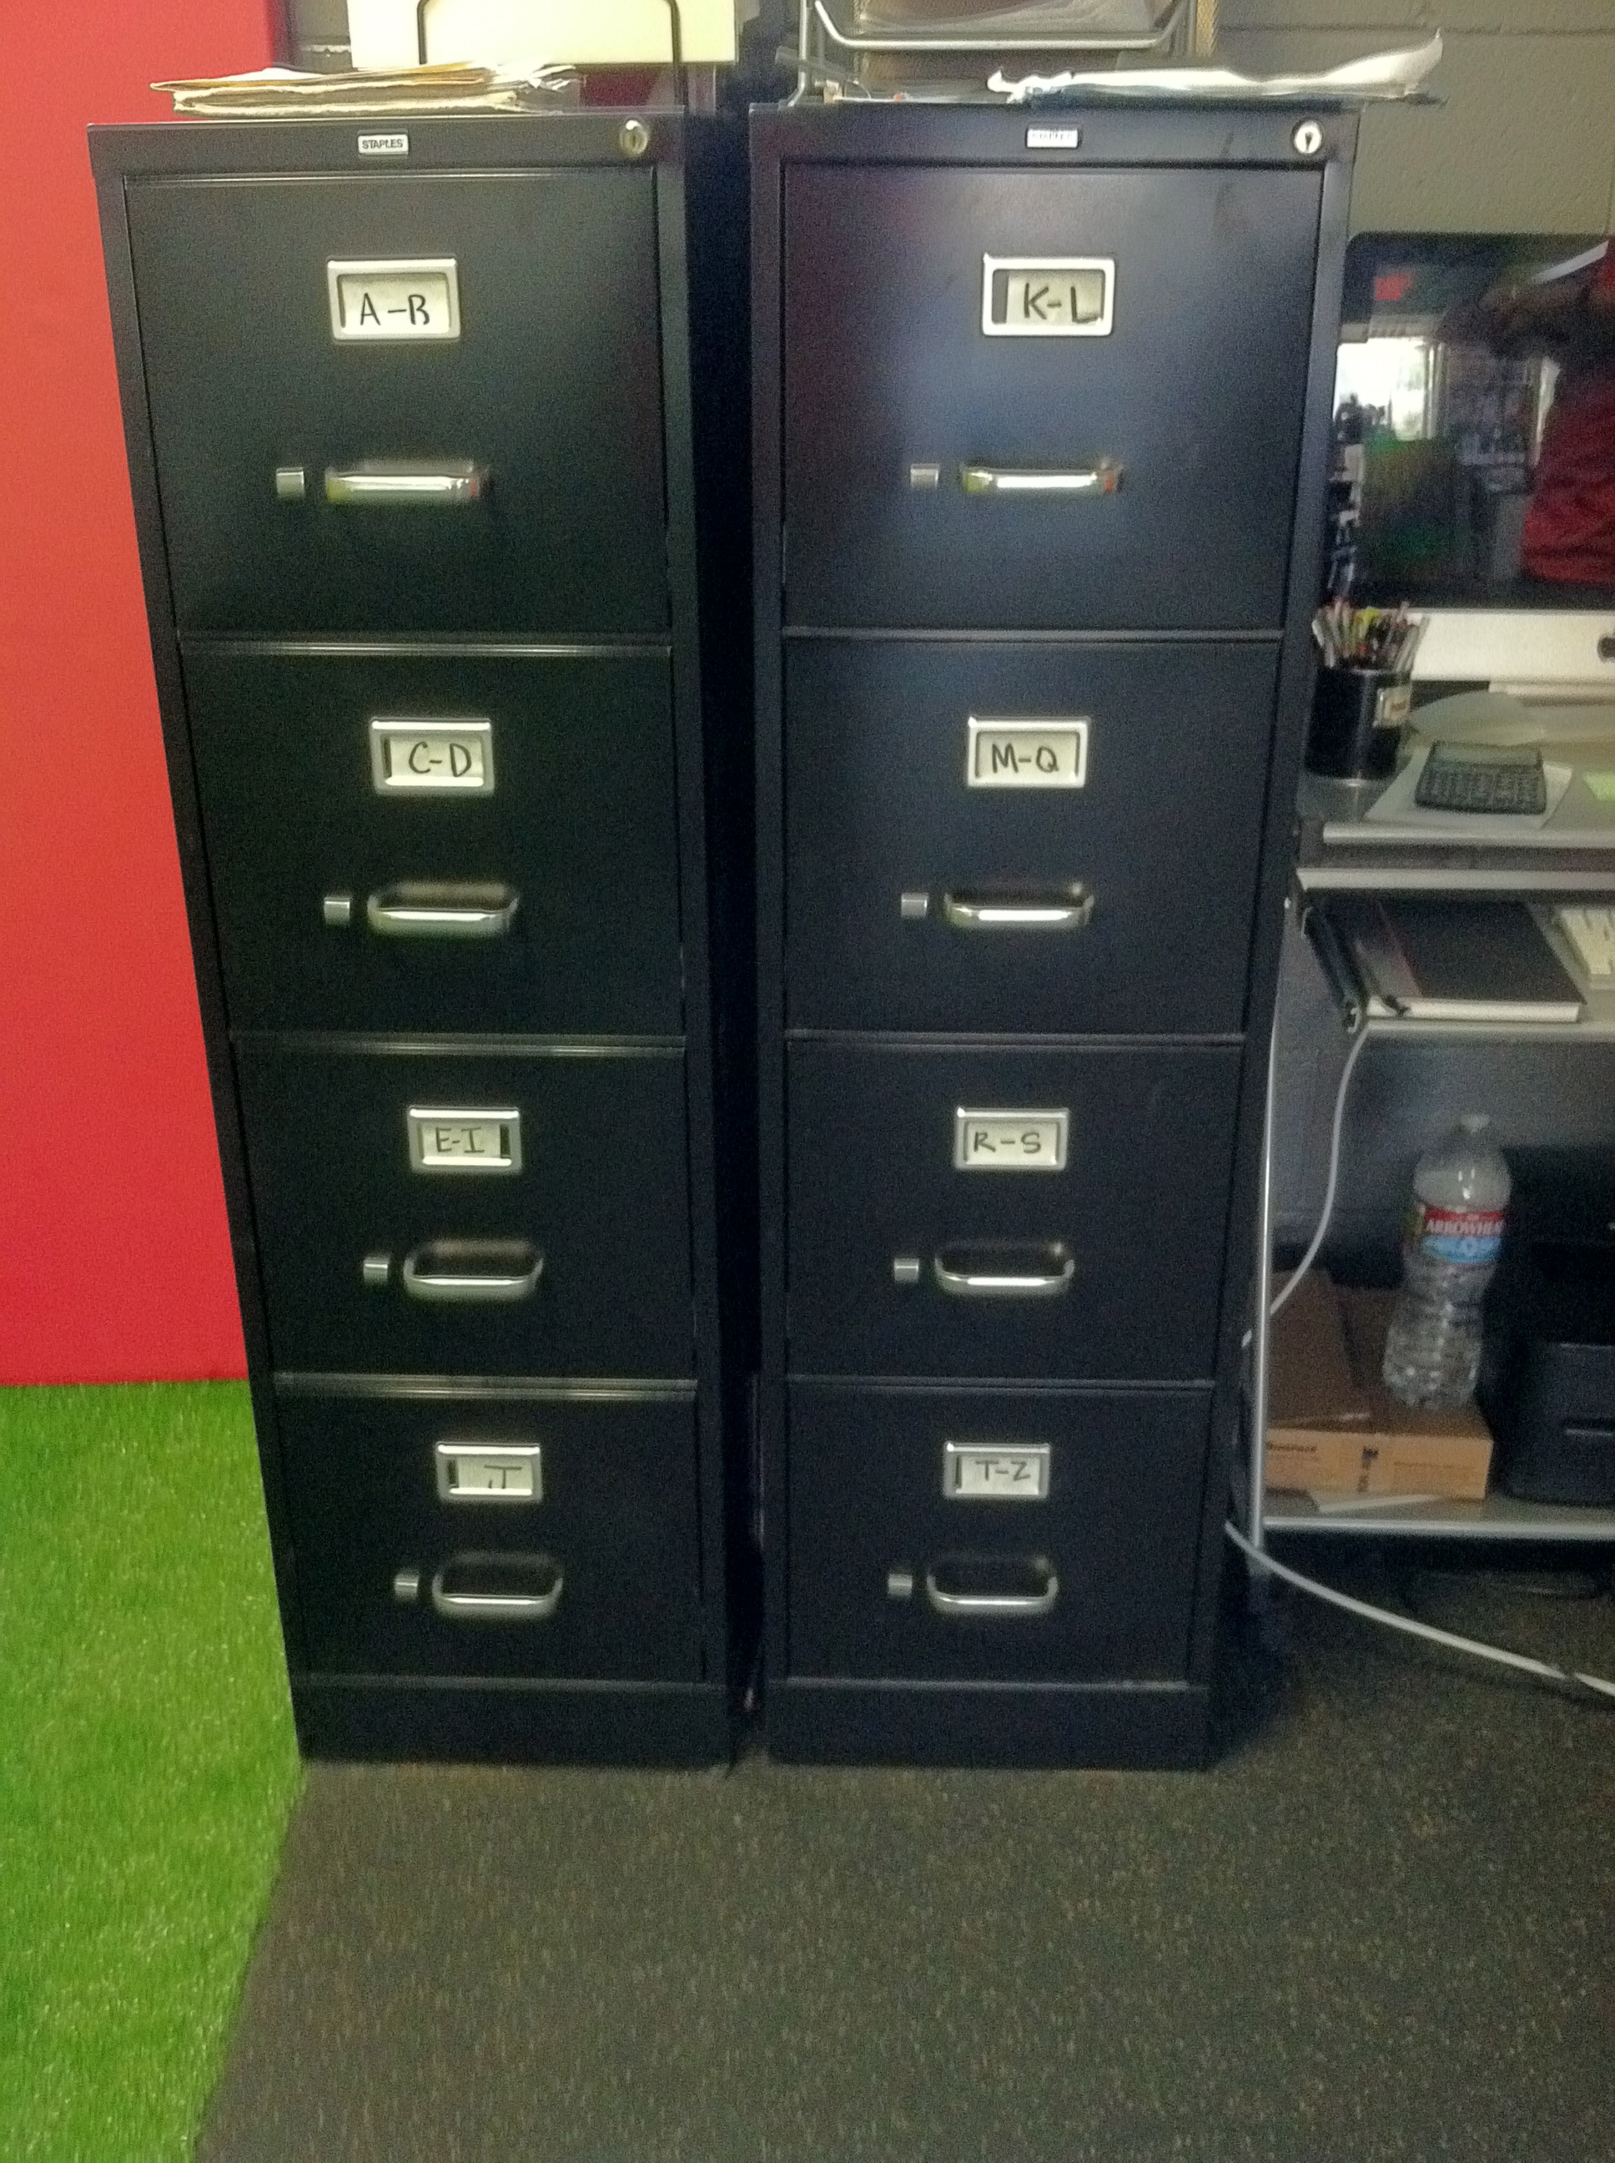
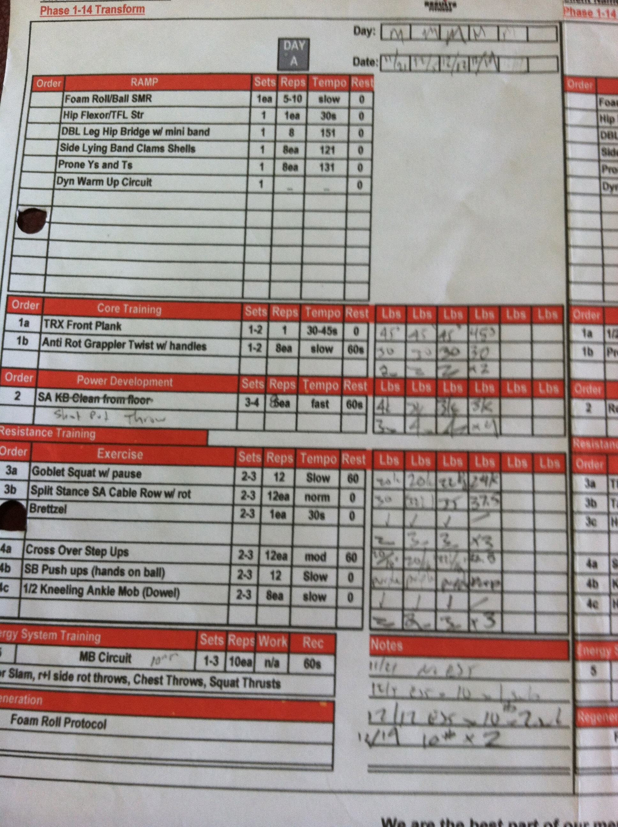
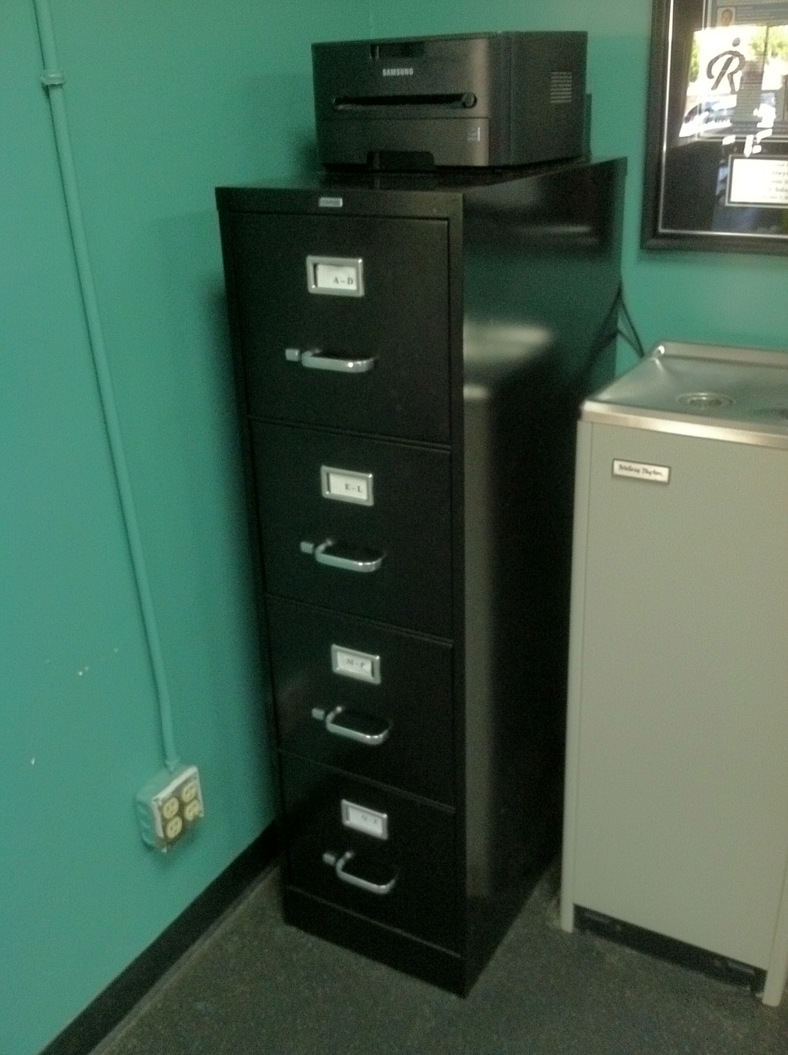
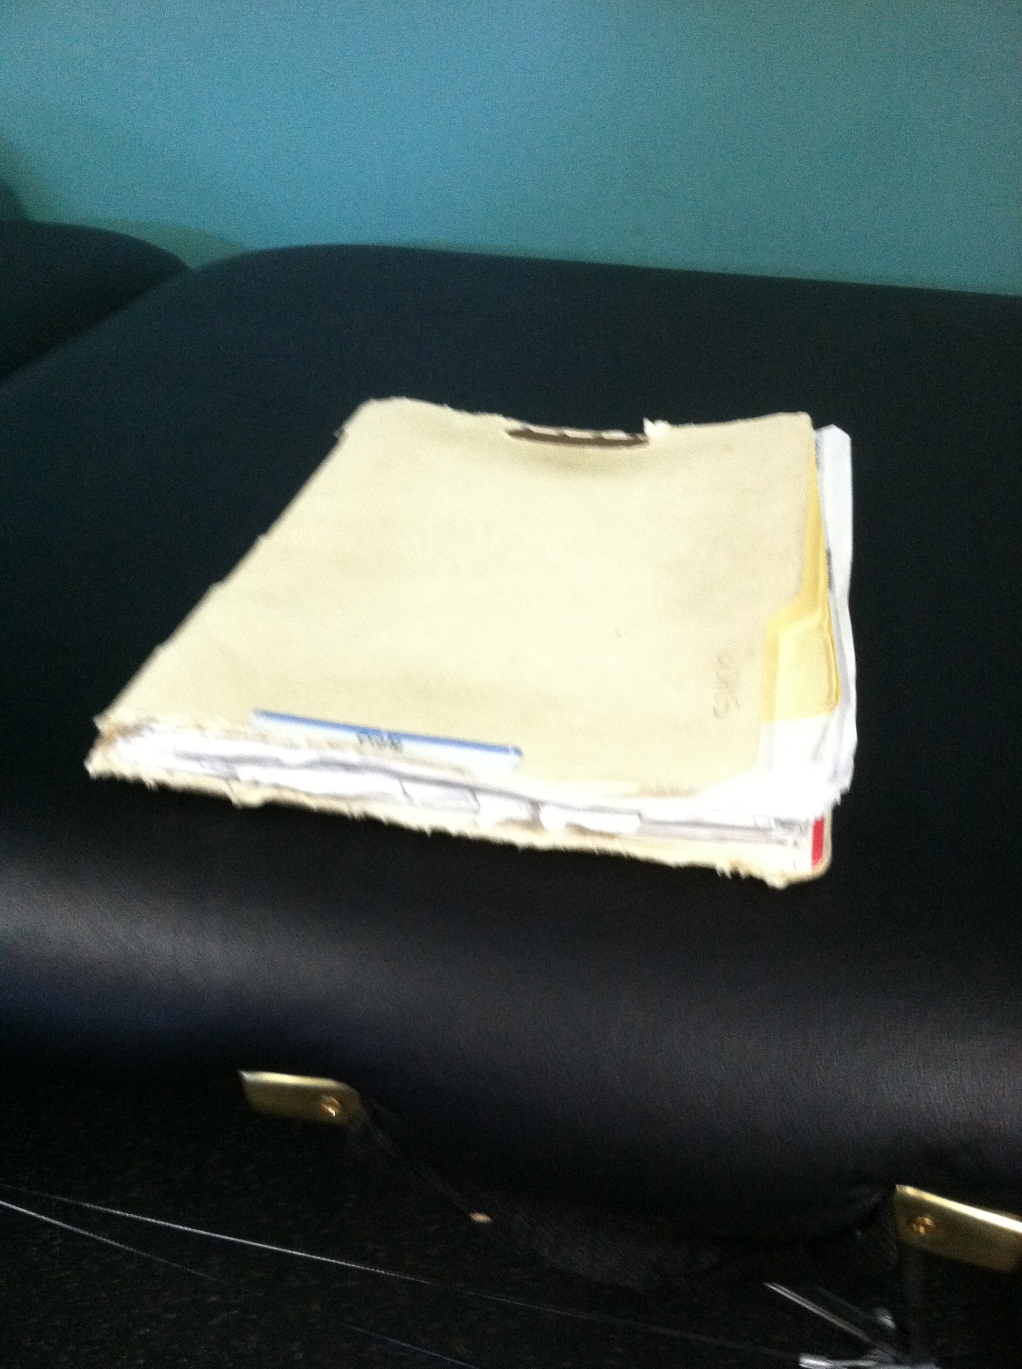
Record Keeping
Notes:
Our logs and how The process works

Slide 17
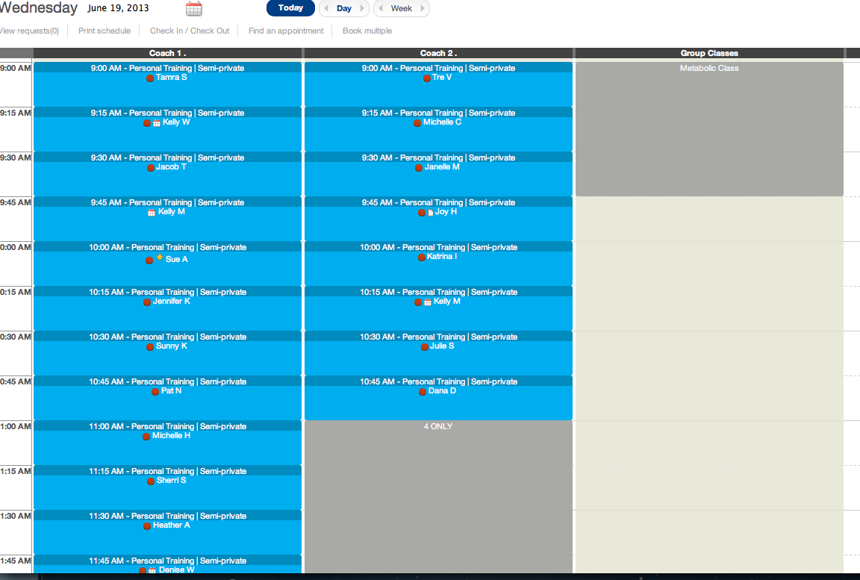

Slide 18
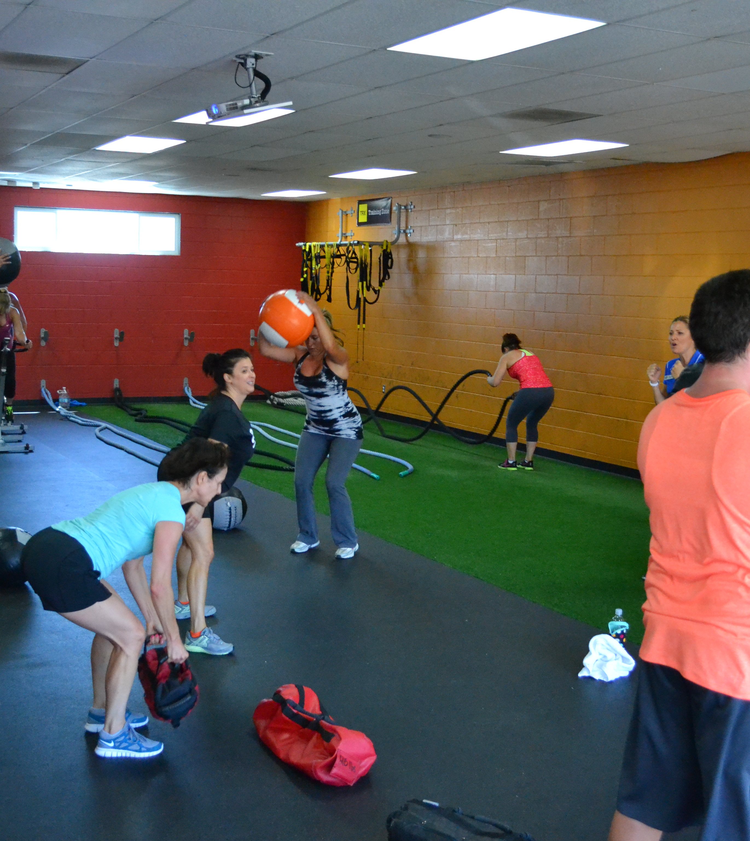
What is Large Group Training?
4-20+ in a class
A generic program (can be individualized slightly)
Globally periodized

Slide 19
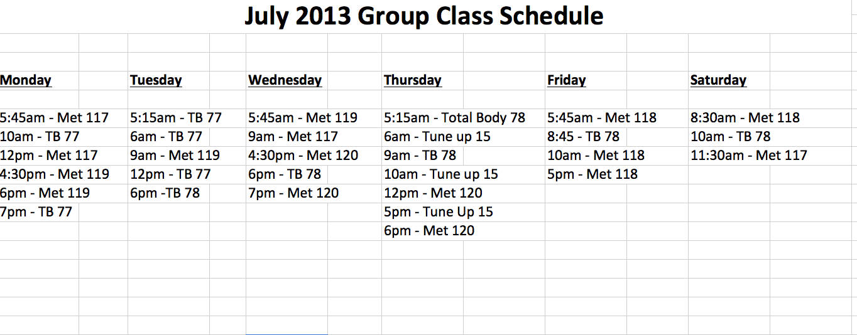

Slide 20
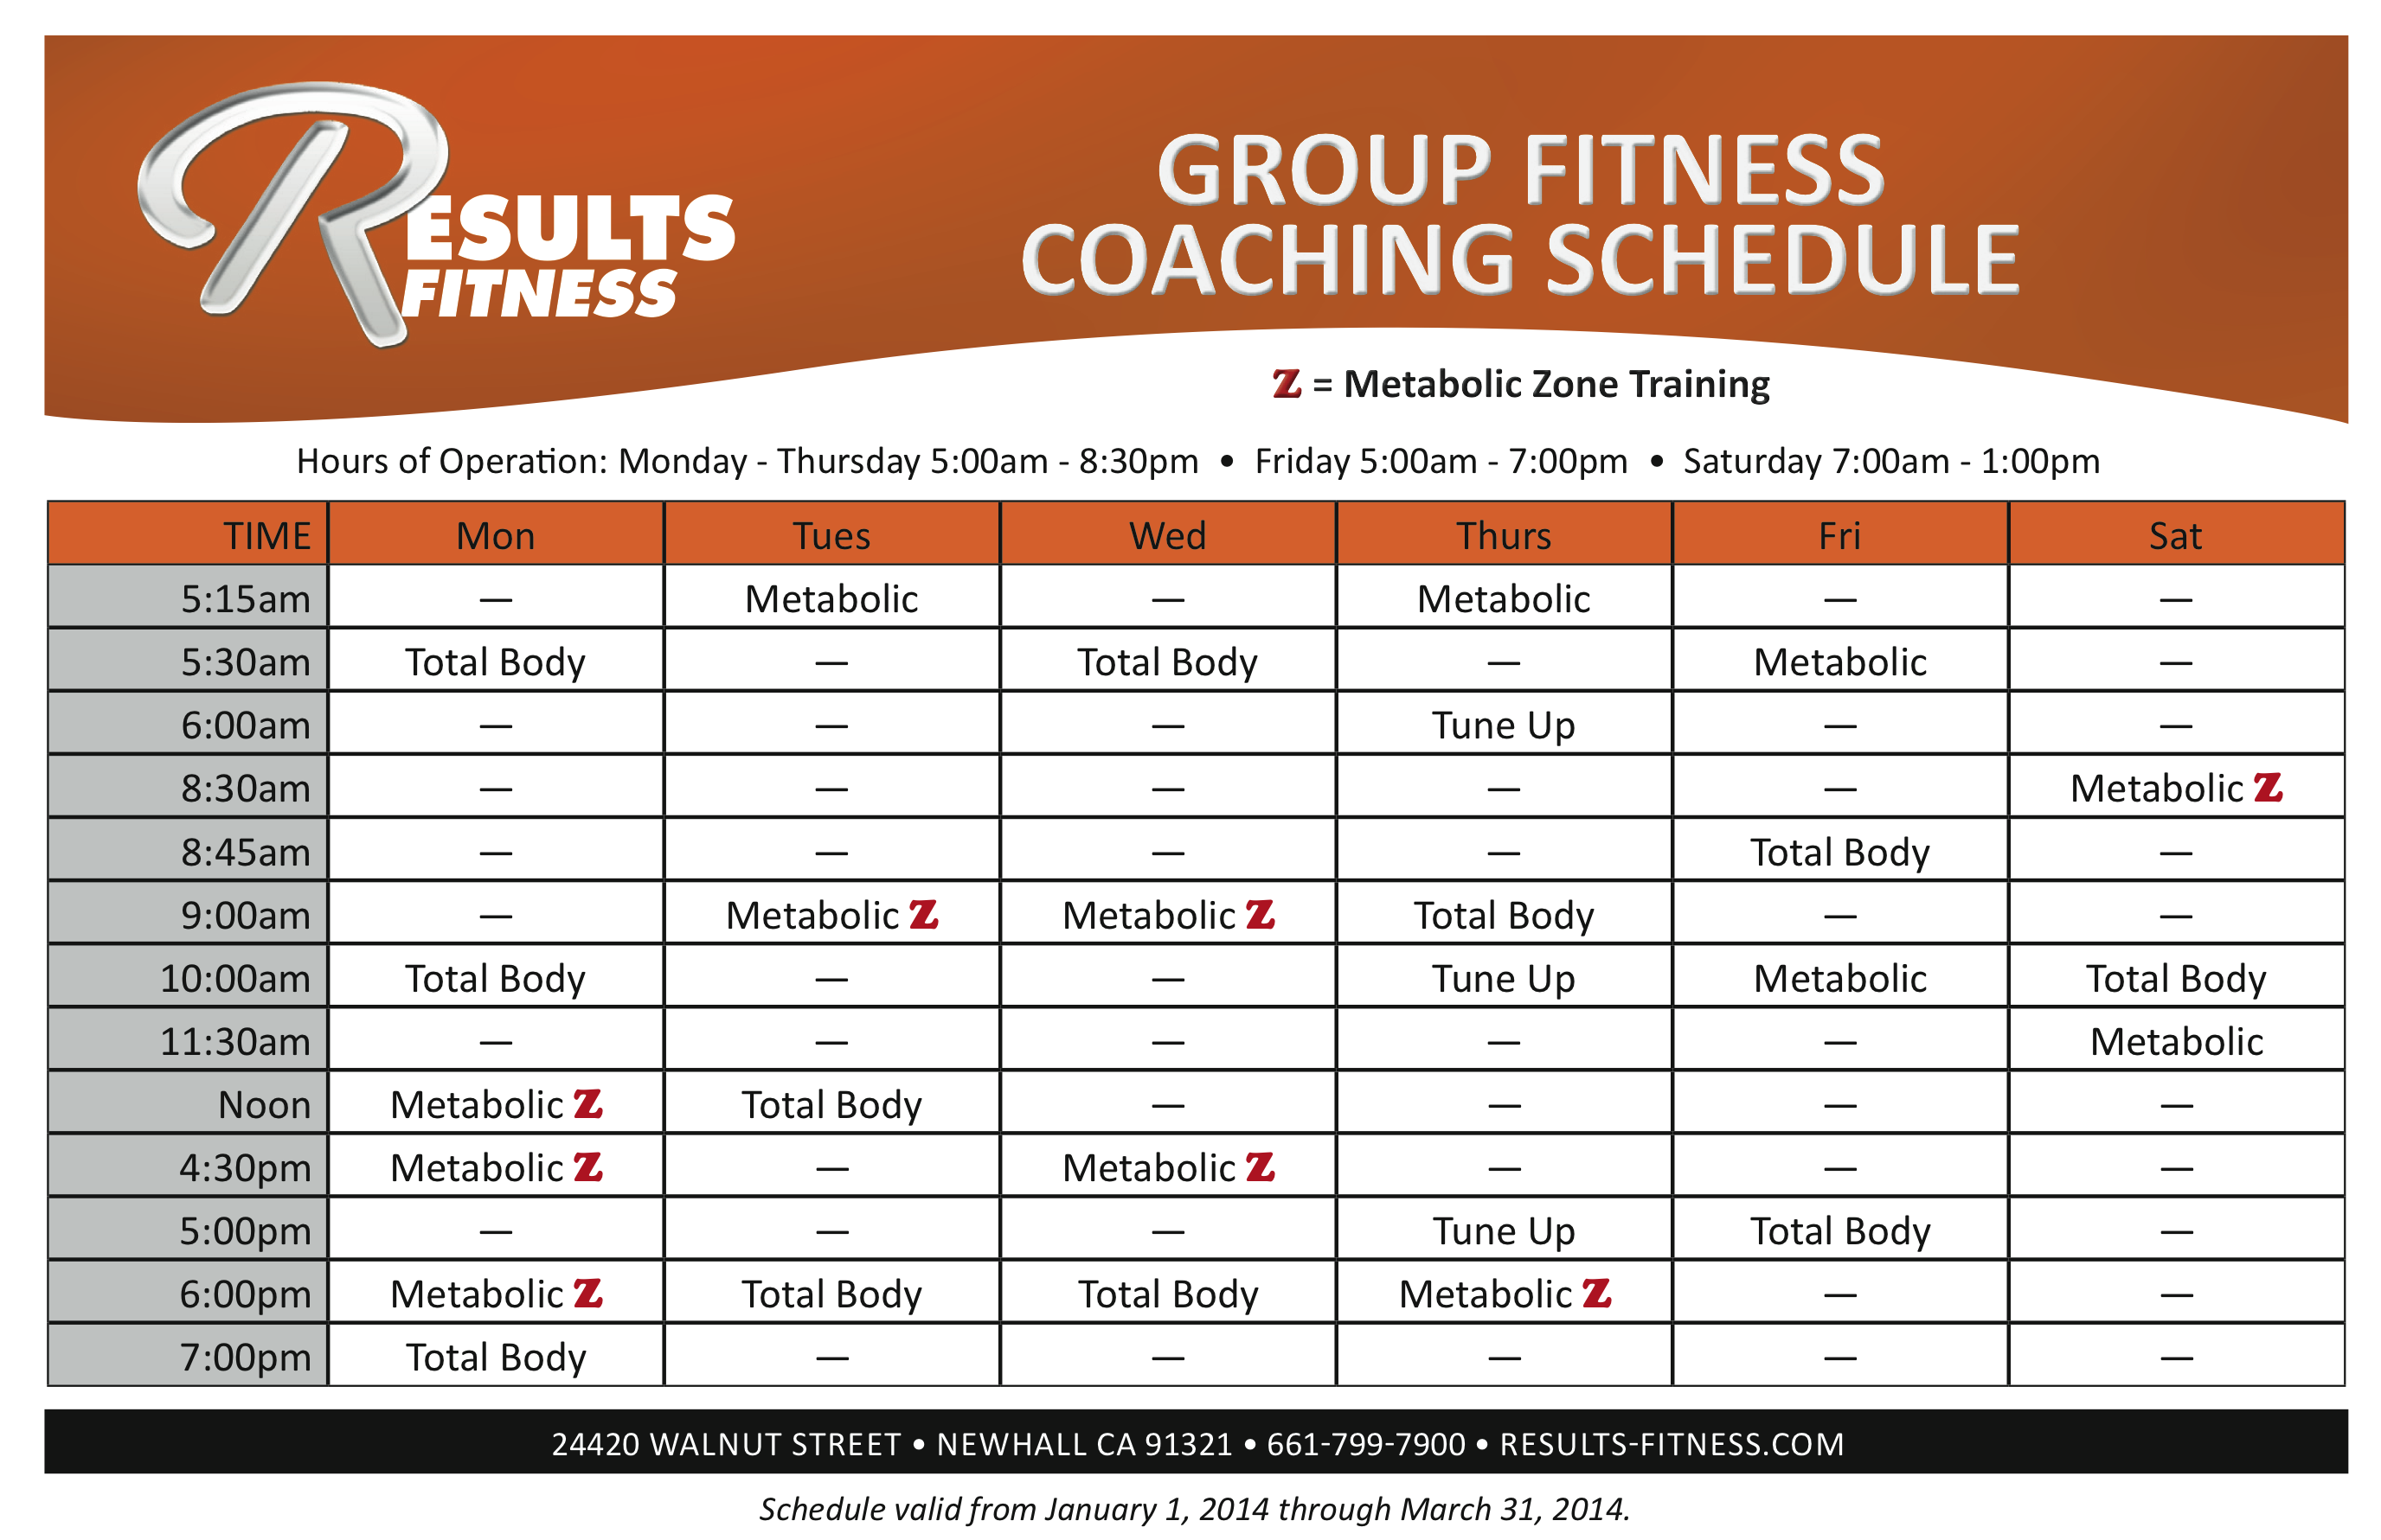

Slide 21
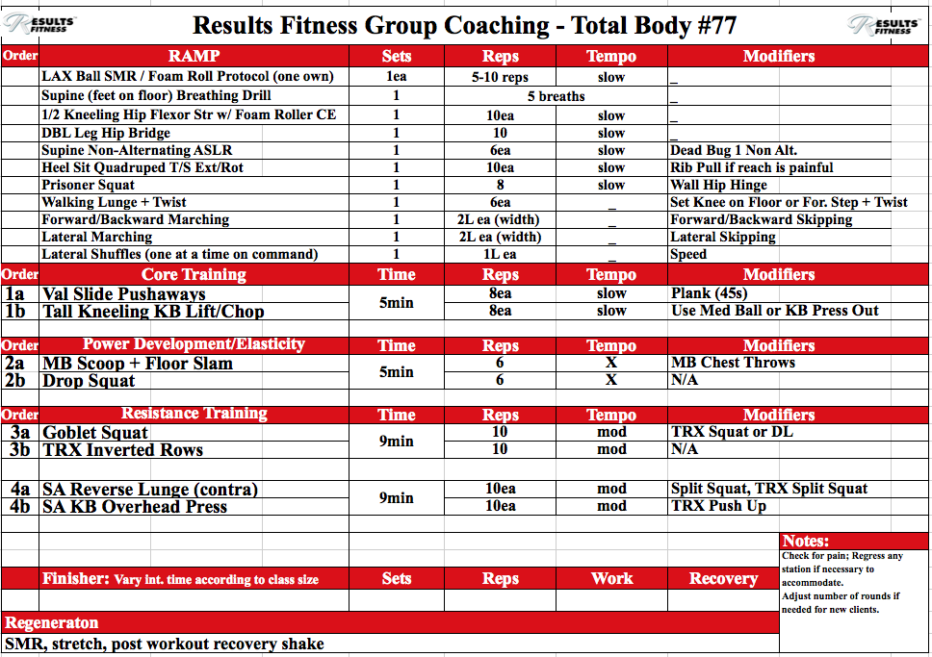

Slide 22
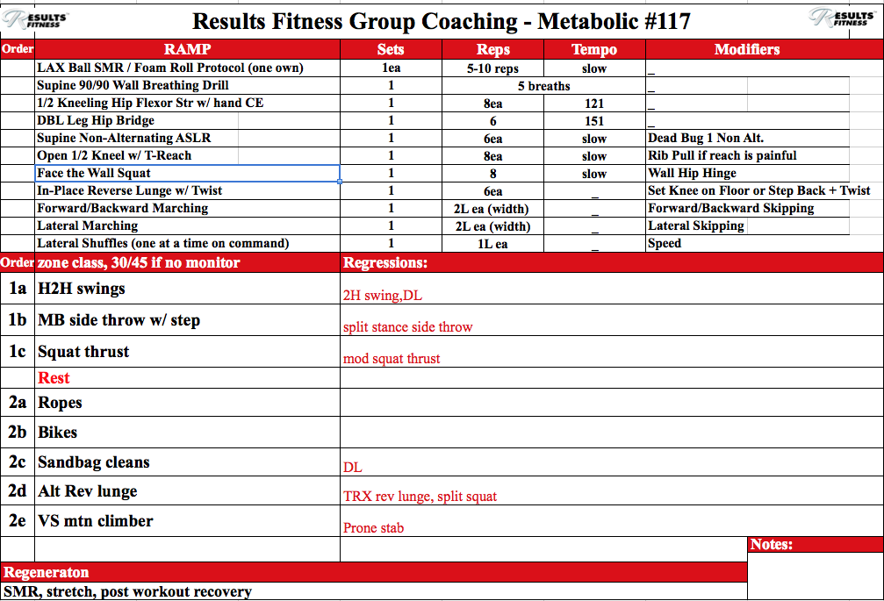

Slide 23
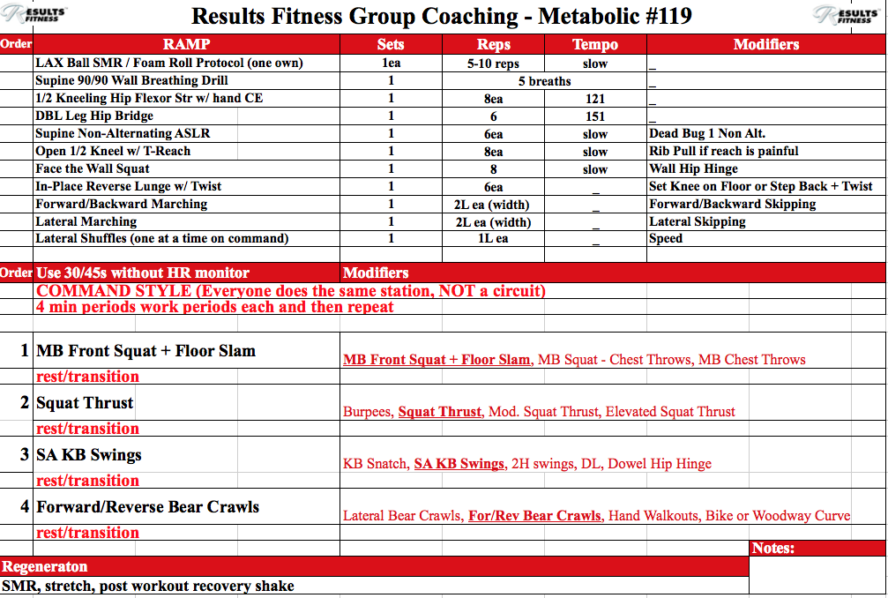

Slide 24
Metabolic Interval Training Protocols
Fixed Work, Fixed Recovery*
Fixed Work, Variable Recovery*
Variable Work, Variable Recovery*
Fixed Work, Progressive Recovery*
Regressive Work, Fixed Recovery

Slide 25
Group Training Stuff…
The Evolution of Group at RF
Group vs. Semi-Private
What is Metabolic Class?
What is Total Body (Complete Strength) Class?
Density Training - Loading
Exercise Selections…
Newbies…
“Logistically Undesirable”

Slide 26
More Stuff
How long are classes?
Progressions and regressions are key.
Contraindications?
Periodization
Flaws?

Slide 27
Functioning As a Team
Two people in charge of writing ALL programs
EVERYTHING is documented and records are kept on every single workout
Turning in/reviewing programs

Slide 28
Coaching Thought Process
Is this acceptable?
Identify the BIGGEST problem.
What do you do to fix it first?
What do you do if that doesn’t work?
How do you regress it?
Notes:
Algorithm - Intervene
-teaching tools, modifiers, details, etc. “what are the first words out of your mouth?”
1st Regression is always load

Slide 29
Daily Ops
Schedule Grid - Wednesday
 | COACHES |  |  | CLASSES
5AM to 6AM | Maria | Rob
6AM to 7AM | Maria | Rob |  | 5:45AM Craig
7AM to 8AM | Maria | Rob | Koko
8AM to 9AM | Maria | Rob | Koko
9AM to 10AM | Koko | Rob |  | 9AM Maria
10AM to 11AM | Maria | Rob | Koko
11AM to 12PM | Koko
12PM to 1PM | Trainer Meeting
1PM to 2PM |  | Rob
2PM to 3PM
3PM to 4PM | Kathy | Kyle |  | 4:30PM Kathy
4PM to 5PM | Mike | Janessa
5PM to 6PM | Mike | Kyle
6PM to 7PM | Mike | Janessa |  | 6PM Kathy
7PM to 8:30PM | Mike | Kyle |  | 7PM Kathy
Program Prep: |  | þ Clock In: 15 min. prior to start of shift.
Rob: 5AM, 9AM, 1PM
Maria: 6AM, 8AM |  | þ Fully engaged each coaching session!
Koko: 7AM, 10AM, 11AM
Kyle: 3PM, 5PM, 7PM |  | þ Return programs at end of shift.
Kathy: 4PM
Mike: 6PM |  | þ Clock Out

Slide 30
Training Meetings
Every Wednesday from 12PM-1PM
Agenda:
  Business Stuff Discussion (10 min.)
  Same Page Stuff (25 min.)
  Case Studies (15 min.)
  Coach Education From “Con. Ed.” (10 min.)
Notes:
MiAs, Renewals, Gym Happenings, Open

Slide 31
Other Meetings
Daily Coach Huddles AM/PM
Daily Manger Huddles Mid-day
Weekly Management
Weekly Program Design
Weekly Program Design/Physical Therapy
Weekly “We Got Your Back” Meeting
Quarterly Reviews

Slide 32
?

Slide 33
www.resultsfitnessuniversity.com

