Slide 1

Marketing

Slide 2
What’s in a Name?

Slide 3
Brand
Strong Logo
Memorable Name
What are you legendary for?
Core Values

Slide 4
“I don’t do any marketing, I get all my clients from word of mouth”…

Slide 5

10% of your budget on marketing consistently

Slide 6
Points of Contact
Marketing
T-Shirts
Website
Drive By’s
Front Door
Phone Call
Front area
Your Staff
It is ALL in the Details!

Slide 7
Solution to their problem
They don’t care if you have Kettlebells
They don’t care how many dumbbells you have
They want to FIT IN THEIR JEANS
MUST Show them that you are a solution to their problem!

Slide 8
What does work?
Real Stories
Real People
Before and After Pictures and their story
Provide a Solution
Step into the conversation in their head

Slide 9

Must have a “promise.”
DROP TWO SIZES
Must be a solution to a problem.

Slide 11


Slide 12
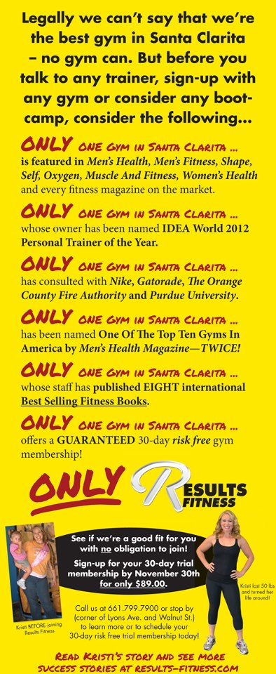

Slide 13
3 Types of People
Visual- People who need to see Results
Auditory- People who need to hear their friends stories
Kinesthetic- People who need to Experience

Slide 14
Marketing
Website
Media
G.I.F.T.
Social Media
Direct Mail
Magazine/Newspaper Ads
Newsletters

Slide 15
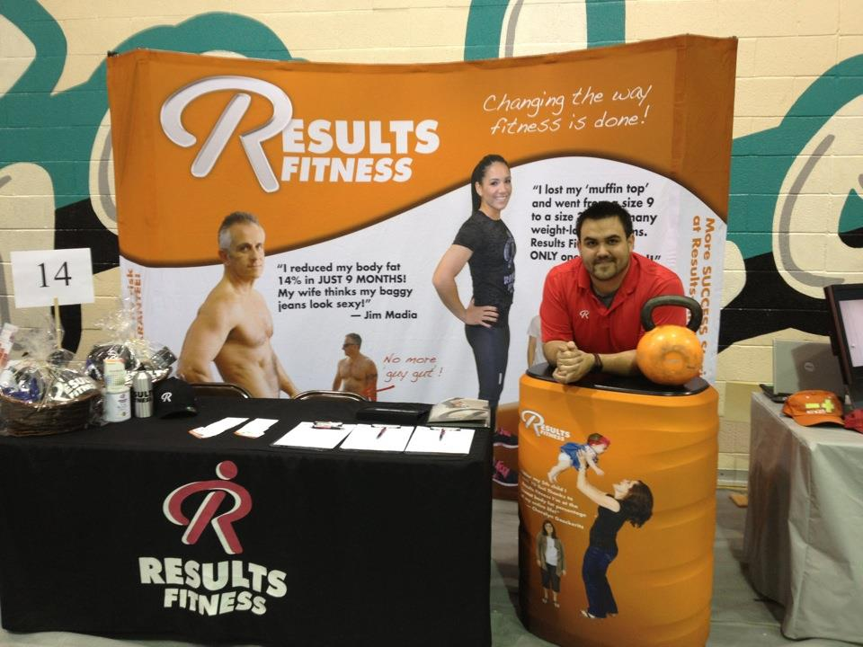
G.I.F.T

Slide 18

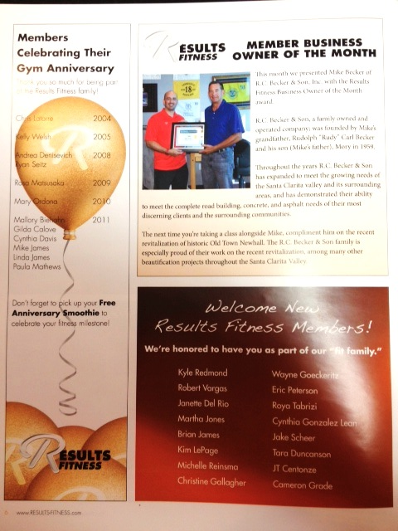
Community

Slide 19

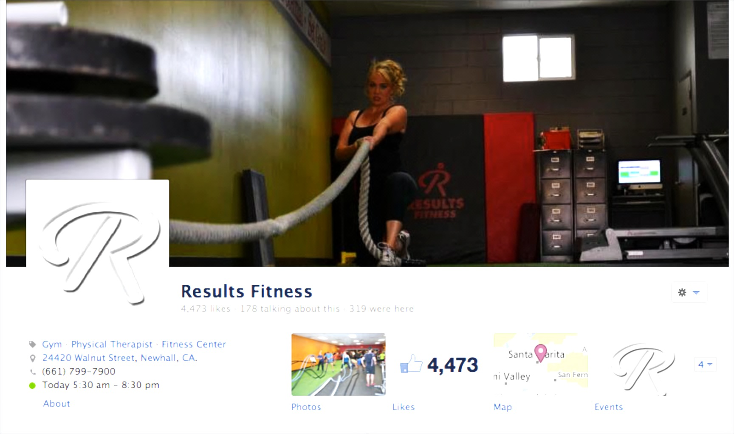
Community

Slide 20
The Hierarchy of Marketing
1) Get Great Results!
2) Figure out your message
3) Referrals
4) Website up and a Facebook Fan page.
5) Build a List.
6) G.I.F.T.
7) Network
8) Local Press and Press Releases
Track your prospects – are you getting AT LEAST 10 leads a month? If not start over with #1 until you are.
RESULTS FITNESS BIZ RULE: If you are not already getting at least 10 prospects a month DO NOT spend $ on other advertising.

Slide 21
Hit them over the head
TOMA
7-10X

Slide 22
You Must Track

Slide 23
Need 6 New Members
1700 Marketing ➔17 Call(1%) ➔ 10 Show Up(60%) ➔ 6 Sign(60%)
If you are not getting 17 calls a month (or 1 call a day) you need to
TAKE ACTION!

Slide 24
www.resultsfitnessuniversity.com

